Slide 1

thank you all
as always
Notes:
thank you for not dropping the class:)
truly appreciate your support

Slide 2
Fundamentals of Computer Design - Basics
02
Kai Bu
kaibu@zju.edu.cn
http://list.zju.edu.cn/kaibu/comparch2022
Notes:
In today’s lecture, we will warm up with computer design basics

Slide 3
Fundamentals of Computer Design - Basics
which types of computers?
why are computers so fast?
what is computer architecture?
Notes:
such as computer classes, major techniques for fast computation, and the definition of computer architecture.
Only after we know in what ways we are evaluating computer performance can we know what to guarantee and improve upon designing computer architecture

Slide 4

too many
concepts ahead
Notes:
An overview chapter, so many concepts to unfold

Slide 5
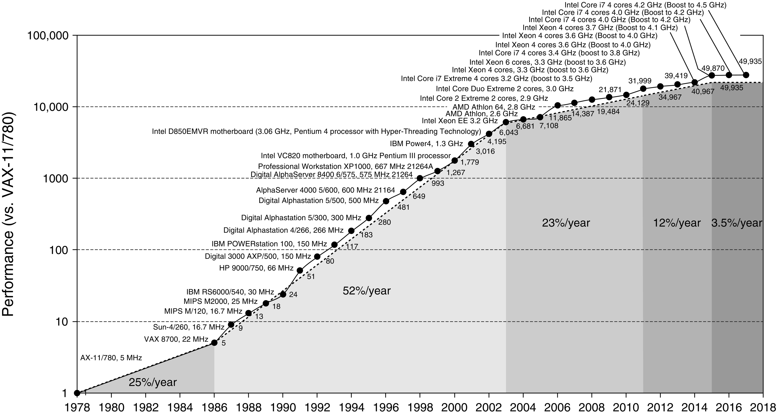
Processor Perf Growth
A 40-Year Lookback
Notes:
The ultimate goal of this course is to understand techniques that keep improving processor performance.
Before unfolding the mystery, let’s take a 40-year lookback at the growth of processor performance.
(with the performance of 1978-processor as a reference)
::
Figure 1.1 Growth in processor performance over 40 years. This chart plots program performance relative to the VAX 11/780 as measured by the SPEC integer benchmarks (see Section 1.8).
Prior to the mid-1980s, growth in processor performance was largely technology-driven and averaged about 22% per year, or doubling performance every 3.5 years. The increase in growth to about 52% starting in 1986, or doubling every 2 years, is attributable to more advanced architectural and organizational ideas typified in RISC architectures. By 2003 this growth led to a dif- ference in performance of an approximate factor of 25 versus the performance that would have occurred if it had continued at the 22% rate. In 2003 the limits of power due to the end of Dennard scaling and the available instruction-level parallelism slowed uniprocessor performance to 23% per year until 2011, or doubling every 3.5 years. (The fastest SPECintbase performance since 2007 has had automatic parallelization turned on, so uniprocessor speed is harder to gauge. These results are limited to single-chip systems with usually four cores per chip.) From 2011 to 2015, the annual improvement was less than 12%, or doubling every 8 years in part due to the limits of parallelism of Amdahl’s Law. Since 2015, with the end of Moore’s Law, improvement has been just 3.5% per year, or doubling every 20 years! Performance for floating-point-oriented calculations follows the same trends, but typically has 1% to 2% higher annual growth in each shaded region. Figure 1.11 on page 27 shows the improvement in clock rates for these same eras. Because SPEC has changed over the years, performance of newer machines is estimated by a scaling factor that relates the performance for different versions of SPEC: SPEC89, SPEC92, SPEC95, SPEC2000, and SPEC2006. There are too few results for SPEC2017 to plot yet.

Slide 6
Processor Perf Growth
A 40-Year Lookback
17 years of sustained growth of 50+%
Notes:
As shown in this figure, an unprecedented growth rate of over 50% consecutively lasted for about 17 years, from 1986 to 2003.
(The combination of architectural and organizatioal enhancements led to 17 years (1986-2003) of sustained growth in performance at an annual rate over 50%, a rate that is unprecedented in the comptuer industry.)
::
Y-axis meaning, performance metric

Slide 7
RISC Architecture
Reduced Instruction Set Computer
Feature simpler instructions
Present two critical perf techniques: instruction-level parallelism (pipelining and multiple instruction issue); caching
Notes:
A major drive for this rapid performance growth is the RISC architecture, where RISC stands for Reduced Instruction Set Computer.
RISC features simpler instructions and focus the attension of designers on two critical performance techniques:
The exploitation of instruction-level parallelism (initially through pipelining and later through multiple instruction issue);
The use of caches (initially in simple forms and later using more sophisticated organization and optimizations);

Slide 8
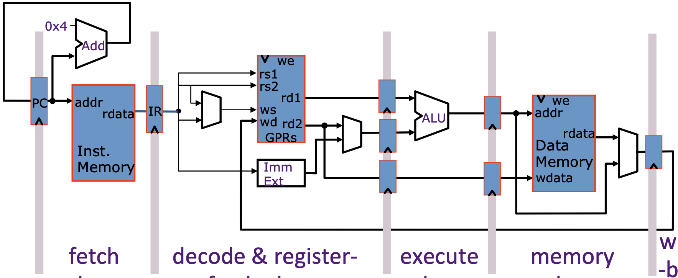
Pipelining
Divide instruction execution into stages
Start next instruction before prior one completes
http://eleclass.princeton.edu/classes/ele475/fall_2016/lib/exe/fetch.php?media=sd2.pdf
Notes:
How it works
And what it supports

Slide 9
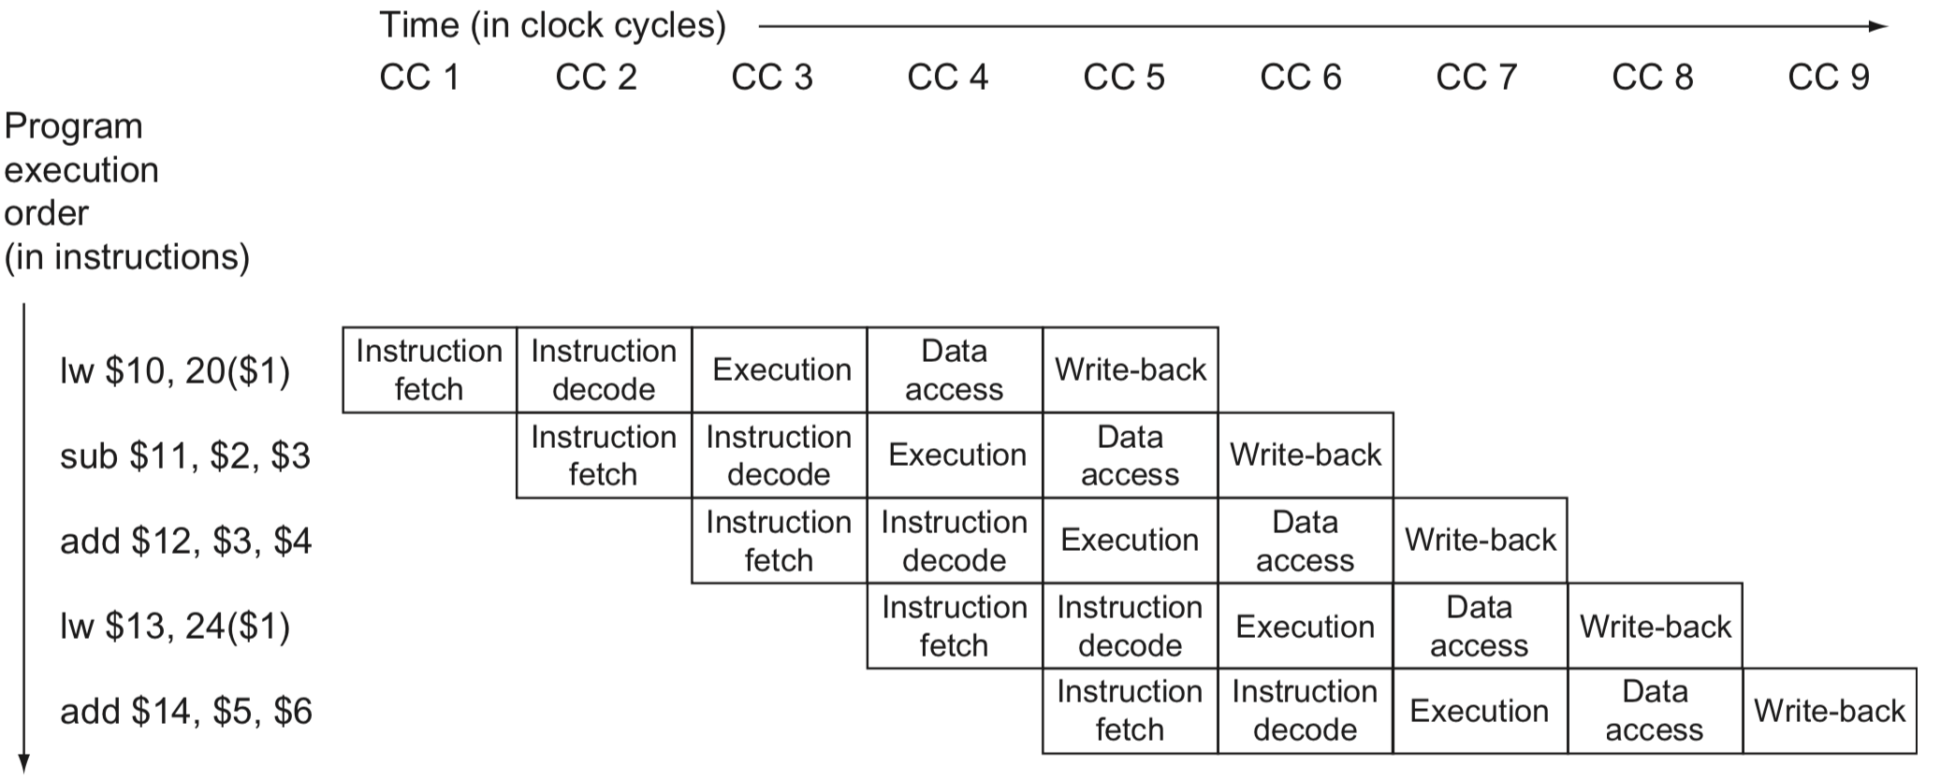
Pipelining
Overlap execution of multi-instruction
CPI >= 1
Notes:
Its essential benefit is to overlap execution of multiple instructions;
And thus speed up program execution and improve system performance
CPI: Cycles Per Instruction
IPC: Instructions Per Cycle

Slide 10
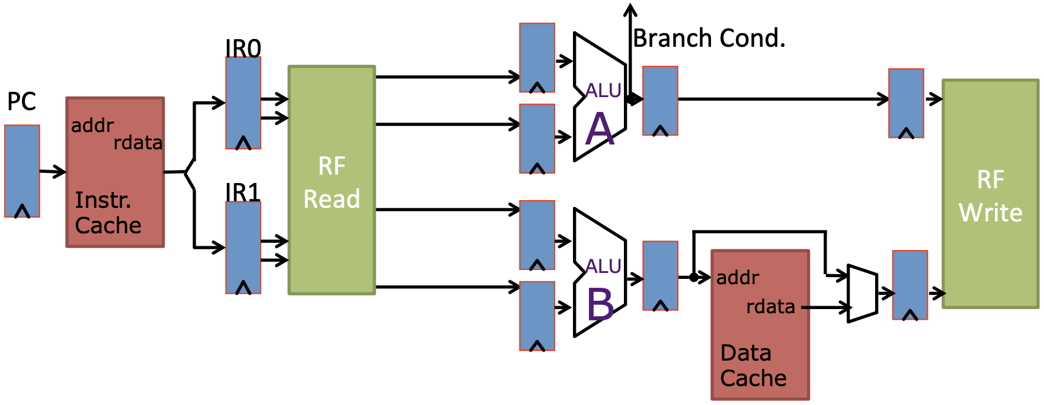
Multiple Instruction Issue
Deploy multiple datapaths
Execute multiple pipelines in parallel
Example: 2-way superscalar
http://eleclass.princeton.edu/classes/ele475/fall_2016/lib/exe/fetch.php?media=sd4.pdf
Notes:
Pipe A: Integer Ops., Branches
Pipe B: Integer Ops., Memory

Slide 11
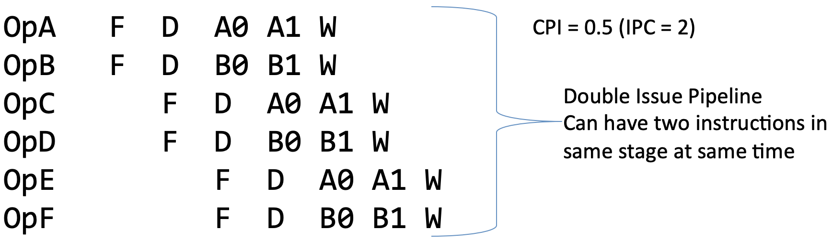
Multiple Instruction Issue
Complete more than one instruction per clock cycle
CPI < 1
Example: 2-way superscalar
http://eleclass.princeton.edu/classes/ele475/fall_2016/lib/exe/fetch.php?media=sd4.pdf

Slide 12
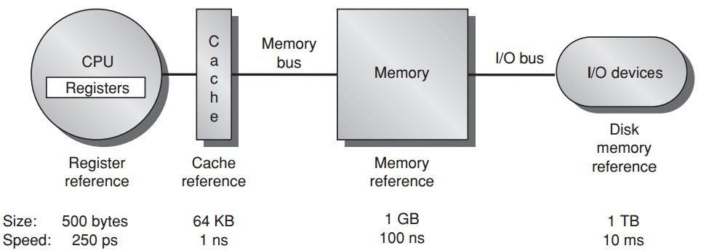
data processing & temporary storage
Notes:
In previous lectures, we spent quite a bit of time on discussing how CPU executes instructions.
Instructions need to operate on data residing in registers.
But register volume is limited, 500 bytes; and architectures support only a limited number of them (32 registers). Thus we can’t put all required operands in registers,
ps: picosecond

Slide 13
temporary storage
Notes:
Instead, we store operands in a much larger memory, and transfer them from memory to registers when necessary.
Nowadays, memory for most pc is up to several gigabytes; sometimes it is still not large enough to hold all data for our programs.
And more importantly, both memory and registers are for temporary storage only. That is, data loaded to register/memory will get lost upon powering down the computer.
So obviously we need another storage medium that not only is much larger than memory but also supports permanent storage.

Slide 14
permanent storage
Notes:
this is where magnetic disk comes in.

Slide 15
permanent storage
Notes:
so far, it seems that we’ve got it all covered.
Cause now we have a large enough disk to permanently store all our data; when we want to run some programs, we preload some data to memory, and then some of which are further loaded to registers during instruction execution. Whenever we cannot find required data in registers, we look for them in memory; and if data absence is still the case, we can finally find them on disks.

Slide 16
permanent storage
*1000 picoseconds = 1 nanosecond = 10⁻⁶ millisecond
Notes:
But the problem is, the gap of processing speed on different storage medium is huge.
Although we can always find expected data in lower levels of the memory hierarchy, we have to slow down instruction execution.
To mitigate such a dilemma,

Slide 17
faster temporary storage
Notes:
We introduce another level of storage medium called cache,
It’s larger than registers but with comparative processing speed.

Slide 18
Caching
Notes:
We introduce another level of storage medium called cache,
It’s larger than registers but with comparative processing speed.

Slide 19
Processor Perf Growth
A 40-Year Lookback
Moore’s Law
Dennard Scailing
Notes:
Moreover, two profound laws were well accepted for profiling the growth rate, Dennard scaling and Moore’s Law; both of which have already been out of date though.

Slide 20
Dennard Scaling
Power density is constant for a given area of silicon even as you increase the number of transistors because of smaller dimensions of each transistor
Ended around 2004 because current and voltage couldn’t keep dropping and still maintain the dependability of integrated circuits
Notes:
One is Dennard Scaling law, intro
So, as transistors get much smaller, turns out to need more power, cause each tiny transistor needs sufficient power for dependability
that is, a lower-bound power usage for supporting a transistor;
::
In 1974 Robert Dennard observed that power density was constant for a given area of silicon even as you increased the number of transistors because of smaller dimensions of each transistor. Remarkably, transistors could go faster but use less power. Dennard scaling ended around 2004 because current and voltage couldn’t keep dropping and still maintain the dependability of integrated circuits.

Slide 21
Moore’s Law
The nubmer of transistors per chip would double every year, as predicted in 1965, which was amended in 1975 to every two years
Ended around 2015
Notes:
The other law is the Moore’s Law;
Given the same chip size and lower bound of transistors, the number of transistors per chip cannot always increase;

Slide 22
Multi-Core Processor
Multiple efficient processors instead of a single inefficient processor
From instruction-level parallelism to data-level and thread-level parallelism
Notes:
These changes force the microprocessor industry to use multiple efficient processors or cores instead of a single inefficient processor
This milestone signaled a historic switch from relying solely on instruction-level parallelism to data-level parallelism and thread-level parallelism

Slide 23
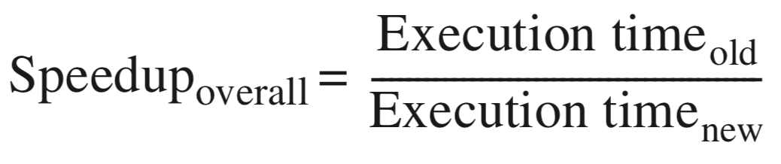
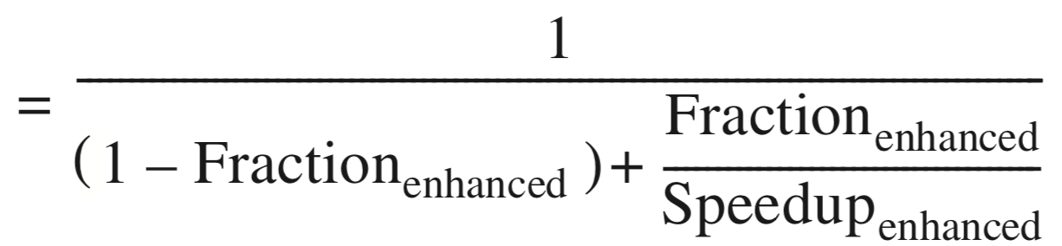
Amdahl’s Law
Multi-core parrallelism requires the restructuring of the application, a major new burden for programmers
Speedup Effect: Amdahl’s Law
Notes:
However, DLP, TLP, and request-level parallism require the restructuring of the application, a major new burden for programmers
To what extent can parallelism speed up program?
Quantified by Amdahl’s Law: Equation

Slide 24
Amdahl’s Law
Multi-core parrallelism requires the restructuring of the application, a major new burden for programmers
Speedup Effect: Amdahl’s Law
limit:
1/(1-Fraction_{enhanced})
so not too many cores
Notes:
However, DLP, TLP, and request-level paral require the restructuring of the application, a major new burden for programmers
To what extent can parallelism speed up program?
Quantified by Amdahl’s Law: Equation
It prescribes practical limits to the number of useful cores per chip.
Example: If 10% of the task is serial, then the maximum performance benefit from parallelism is 10 no matter how many cores you put on the chip

Slide 25
Amdahl’s Law
Multi-core parrallelism requires the restructuring of the application, a major new burden for programmers
Speedup Effect: Amdahl’s Law
limit:
if 10% of task is serial
maximum 10x speedup!
Notes:
However, DLP, TLP, and request-level paral require the restructuring of the application, a major new burden for programmers
To what extent can parallelism speed up program?
Quantified by Amdahl’s Law: Equation
It prescribes practical limits to the number of useful cores per chip.
Example: If 10% of the task is serial, then the maximum performance benefit from parallelism is 10 no matter how many cores you put on the chip

Slide 26
Amdahl’s Law
Make common case fast
Example 1: speedup of 20 on 10% 1/(0.9+0.1/20) = 1.11
Example 2: speedup of 1.6 on 80% 1/(0.2+0.8/1.6) = 1.43

Slide 27
Lhadma’s Law
Yet uncomment case not so slow
Example: improvement of 2x on 90% slow down the rest by 10x speedup = 1/(0.1/0.1+0.9/2) = 0.69
Notes:
Lhadma's Law cautions that in pursuit of optimizing the common case, the uncommon case shouldn't be slowed down too much.

Slide 28
What types of computers?
Notes:
Since all our discussions in this course will relate to computers, then what kinds/types of computers do you know or have? Any examples?

Slide 29
5 Classes of Computers
PMD: Personal Mobile Device
Desktop
Server
Cluster/WSC (Warehouse-Scale Computer)
Embedded/IoT computer
Notes:
Good examples; All those computers you’ve just mentioned fall into these five classes.
The first one is personal mobile device.

Slide 30

PMD: Personal Mobile Device
Wireless devices with multimedia user interfaces
cell phones, tablet computers, etc.
a few hundred dollars
Notes:
Personal mobile devices, such as smartphones and tablets, are the most pervasive computers nowadays.
They have small size, high portability, yet low cost.

Slide 31
PMD Characteristics
Cost effectiveness
less expensive packaging
absence of fan for cooling
Notes:
In comparison with more expensive computers like pcs or laptops,
PMD’s low cost owes to their less expensive packaging and absence of fan for cooling.

Slide 32
PMD Characteristics
Responsiveness & Predictability
real-time performance:
a maximum execution time for each
application segment
example: time to process each video frame should bel limited as processor must accept and process the next frame shortly
Notes:
The expectation for PMD’s responsiveness is that it should satisfy real-time performance constraint.
For this, a segment of the application has an absolute maximum execution time.
For example, in playing a video on a PMD, the time to process each video frame should be limited, since the processor must accept and process the next frame shortly.
However, real-time performance is a very strict requirement; it’s hard to satisfy.

Slide 33
PMD Characteristics
Responsiveness & Predictability
real-time performance:
a maximum execution time for each
application segment
soft real-time:
trade time of a certain event for others’;
tolerate occasionally missed time constraint on an event,
as long as not too many are missed;
Notes:
As an alternative, some applications choose soft real-time performance,
which tolerates occasionally missed time constraint on an event, as long as not too many are missed.

Slide 34
PMD Characteristics
Memory efficiency
optimize code size
Energy efficiency
battery power
heat dissipation
Notes:
For PMD, Memory can be a substantial portion of the system cost; We need to economize memory usage. PMD hosts various applications and thus large volume of code; so we can optimize code size toward memory efficiency;
Besides, PMD also has limited power and has no fan for cooling; so economizing battery usage and heat dissipation technique are key to save energy;

Slide 35

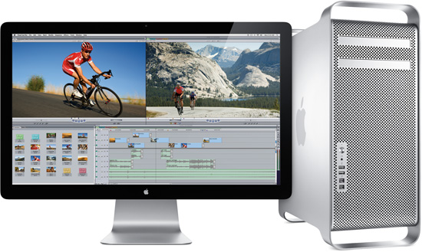
Desktop Computing
Largest market share
low-end netbooks: $x00
high-end workstations: $x000
Notes:
Desktops and laptops take largest market share and are most familiar to us.
They range from low-end netbooks to high-end workstations.
They usually cost hundreds to thousands of dollars

Slide 36
Desktop Characteristics
Price-Performance
combination of performance and price;
compute performance
graphics performance
The most important to customers,
and hence to computer designers
Notes:
Desktops deliver high performance but cost affordable prices.
So they are the most important to customers and hence to computer designers.

Slide 37
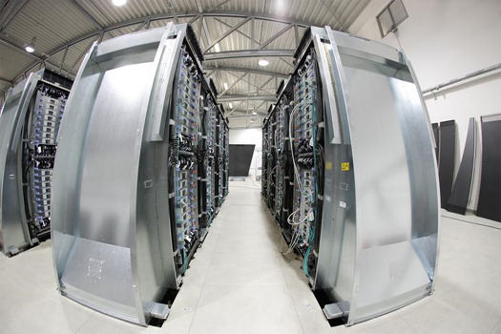
Servers
Provide large-scale and reliable file and computing services (to desktops)
Constitute the backbone of large-scale enterprise computing
Notes:
Servers aim to provide large-scale and reliable file and computing services to desktops connected to them.
They constitute the backbone of large-scale enterprise computing.

Slide 38
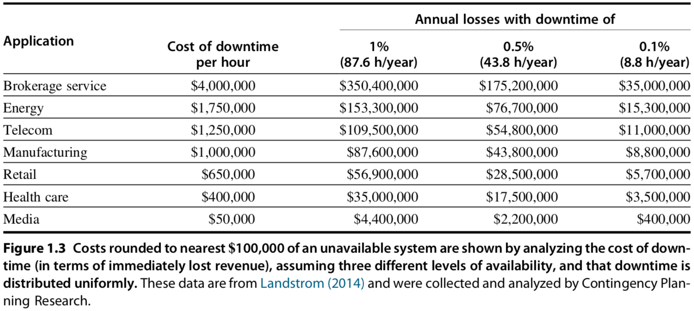
Servers Characteristics
Availability
against high-cost server failure
Notes:
The major character of servers should be high availability, as server down usually costs a lot to hosting services.
For some critical network services like credit card authentication and ATM operations, server failure comes at too high a cost.

Slide 39
Servers Characteristics
Scalability
in response to increasing demand with scaling up computing capacity, memory, storage, and I/O bandwidth
High throughput
handling more requests in a unit time:
in terms of transactions per minute or web pages served per second
Notes:
Servers should also be scalable, that is, they should be capable of handling a large volume of service requests.
Toward this, it might need to enhance computing and storage capacity.
We also expect that servers have high throughput, that is, handling more requests in a unit time.
::
A second key feature of server systems is scalability. Server systems often grow in response to an increasing demand for the services they support or an expansion in functional requirements. Thus the ability to scale up the computing capacity, the memory, the storage, and the I/O bandwidth of a server is crucial.
Finally, servers are designed for efficient throughput. That is, the overall per- formance of the server—in terms of transactions per minute or web pages served per second—is what is crucial. Responsiveness to an individual request remains important, but overall efficiency and cost-effectiveness, as determined by how many requests can be handled in a unit time, are the key metrics for most servers.

Slide 40

Clusters/WSCs
Warehouse-Scale Computers
collections of desktop computers or servers
connected by local area networks (LANs)
to act as a single larger computer
Characteristics
price-performance, availability, power
Notes:
Clusters are also known as werehouse-scale computers; they are collections of pcs/servers
Then the connected computers can act as a single larger computer.
Its Characteristics are similar to its components, that is, desktop and server: which are, for example, price-performance and availability
Besides, since it consists of a bunch of computers altogether, we need to economize its power consumption;

Slide 41
Clusters/WSCs
(Difference from) Supercomputers
emphasize floating-point performance;
run large, communication-intensive batch programs that can run for weeks at a time;
WSCs
emphasize interactive applications, large-scale storage, dependability, and high Internet bandwidth
Notes:
Supercomputers are related to WSCs in that they are equally expensive, costing hundreds of millions of dollars, but supercomputers differ by emphasizing floating-point performance and by running large, communication-intensive batch programs that can run for weeks at a time.
In contrast, WSCs emphasize interactive applications, large-scale storage, dependability, and high Internet bandwidth.

Slide 42

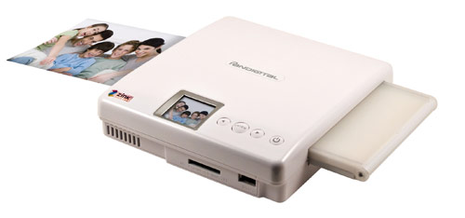
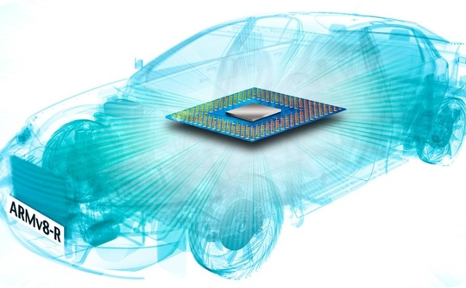
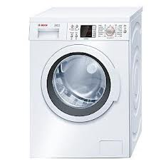
Embedded Computers
hide everywhere
Notes:
Embedded computers just hide everywhere. They are in cameras, washing machines, drones, and even our cars/automobiles.

Slide 43

Embedded Computers
Internet of Things (IoT)
connected to Internet wirelessly
Notes:
The phrase of Internet of Things (IoT) refers to embedded computers that are connected to the Internet, typically wirelessly.
The projections for the number of IoT devices in 2020 range from 20 to 50 billion.

Slide 44
Embedded vs Non-embedded
Dividing line:
the ability to run third-party software
Embedded computers’ primary goal:
meet the performance need at a minimum price;
rather than achieve higher performance at a higher price
Notes:
How can we differ embedded computers from non-embedded ones?
The key clue is whether a computer got the ability to run third-party software.
After all, embedded computers are made to meet the performance need at a minimum price
rather than achieve higher performance at a higher price.
Any questions?

Slide 45
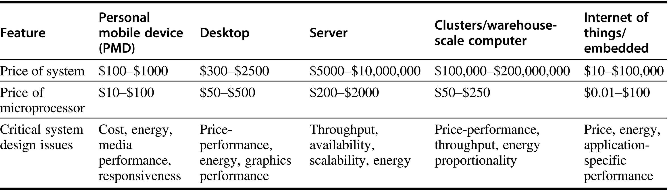
Summary & Comparison
Notes:
Figure 1.2 A summary of the five mainstream computing classes and their system characteristics. Sales in 2015 included about 1.6 billion PMDs (90% cell phones), 275 million desktop PCs, and 15 million servers. The total number of embedded processors sold was nearly 19 billion. In total, 14.8 billion ARM-technology-based chips were shipped in 2015. Note the wide range in system price for servers and embedded systems, which go from USB keys to network routers. For servers, this range arises from the need for very large-scale multiprocessor systems for high-end trans- action processing.

Slide 46

Summary & Comparison
performance matters

Slide 47
What makes computers fast?
Notes:
What makes these types of computers so fast?
Any ideas?

Slide 48
Parallelism
Multi-task simultaneously takes effect
application parallelism
hardware parallelism
Notes:
The answer is parallelism, it makes multiple tasks to simultaneously take effect;
We can explore parallelism in both application layer and hardware layer.

Slide 49
Application Parallelism
DLP: Data-Level Parallelism
many data items being operated on at the same time
TLP: Task-Level Parallelism
tasks of work created to operate independently and largely in parallel
*parallelization across multiple processors
in parallel computing environments
Notes:
For application parallelism, we have data-level parallelism and task-level parallelism.
DLP operates many data items at the same time; (example: addition computation)
TLP creates tasks of work such that they operate independently and largely in parallel.
Both parallelisms strive for parallelization across multiple processors in parallel computing environments

Slide 50
Application Parallelism
DLP: Data-Level Parallelism
many data items being operated on at the same time;
distribute the same data across different processors;
Notes:
Essentially, DLP focuses on distributing the data across different processors, which operate on the data in parallel.

Slide 51
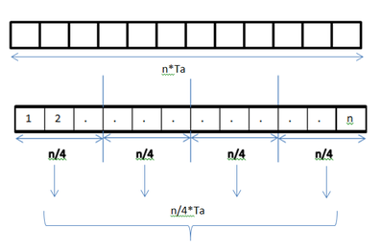
Application Parallelism
DLP: Data-Level Parallelism
many data items being operated on at the same time;
distribute the same data across different processors;
Example 1:
add elements in an array;
each addition takes Ta time units;
1 processor vs 4 processors

Slide 52
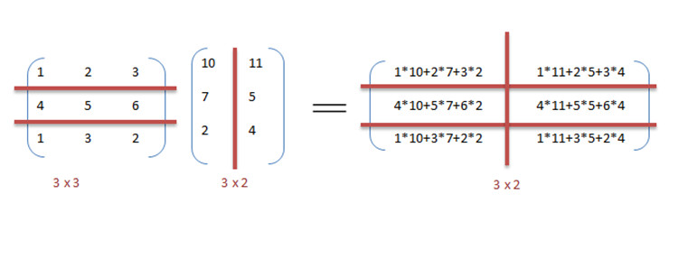
Application Parallelism
DLP: Data-Level Parallelism
many data items being operated on at the same time;
distribute the same data across different processors;
Example 2:
matrix
multiplication
1 processor vs 6 processors

Slide 53
Application Parallelism
TLP: Task-Level Parallelism
tasks of work created to operate independently and largely in parallel;
run many different tasks at the same time on the same data;
Example:
input a bitstring to two processors;
processor A counts bit 0 or 1;
processor B computes its complement;
Notes:
In contrast to data level parallelism that runs the same task on different components of data, TLP runs many different tasks at the same time on the same data.

Slide 54
Hardware Parallelism
Hardware exploits app parallelism
in four ways:
ILP: Instruction-Level Parallelism
Vector Architectures, GPUs, and MM
TLP: Thread-Level Parallelism
RLP: Request-Level Parallelism
Notes:
::
Computer hardware in turn can exploit these two kinds of application parallelism in four major ways:
For hardware parallelism, we have four possible ways.
(Vector Architectures, GPUs - Graphic Process Units, and MM – Multimedia Instruction Sets)
The first one is instruction-level parallelism.

Slide 55
Hardware Parallelism
ILP: Instruction-Level Parallelism
exploits data-level parallelism
at modest levels – pipelining
divide a task to steps;
simultaneously run different steps
of different tasks.
at medium levels – speculative execution
do some work in advance;
prevent delay when the work is needed.
Notes:
Instruction-level parallelism exploits data-level parallelism;
At modest levels, it works through pipelining. Pipelining is the most important topic of our lecture and lab sessions.
It divides a task to steps, and then simultaneously runs different steps of different tasks.
At medium levels, instruction-level parallelism works through speculative execution. It runs some task in advance in order to prevent delay when the task’s result is needed.

Slide 56
Pipelining
Divide instruction execution into stages
Start next instruction before prior one completes
http://eleclass.princeton.edu/classes/ele475/fall_2016/lib/exe/fetch.php?media=sd2.pdf
Notes:
Again, about pipelining, here’s how it works
And what it supports

Slide 57
Pipelining
Overlap execution of multi-instruction
CPI >= 1
Notes:
Its essential benefit is to overlap execution of multiple instructions;
And thus speed up program execution and improve system performance
CPI: Cycles Per Instruction
IPC: Instructions Per Cycle

Slide 58
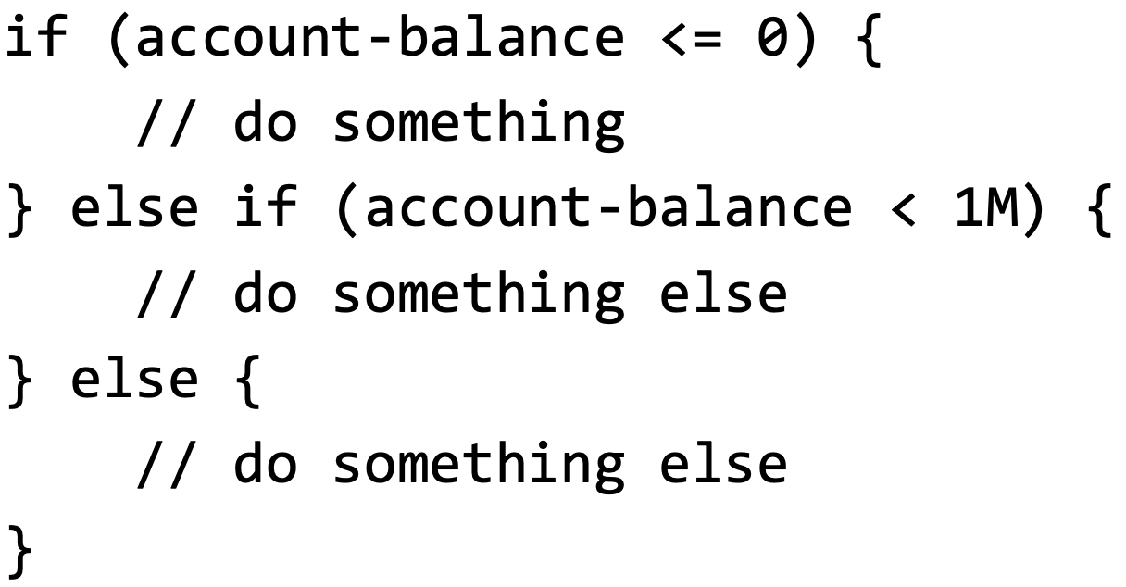
Speculative Execution
Guess what code will be executed and execute it speculatively
Improve performance, if it takes a long time to access account-balance
https://safari.ethz.ch/digitaltechnik/spring2021/lib/exe/fetch.php?media=onur-digitaldesign_comparch-2021-lecture2b-mysteries-afterlecture.pdf

Slide 59
Speculative Execution
Guess what code will be executed and execute it speculatively
Upon wrong guess, flush the wrong instructions & execute the correct code
https://safari.ethz.ch/digitaltechnik/spring2021/lib/exe/fetch.php?media=onur-digitaldesign_comparch-2021-lecture2b-mysteries-afterlecture.pdf

Slide 60
Hardware Parallelism
Vector Architectures & GPUs & Multimedia Instruction Sets
exploit data-level parallelism;
apply a single instruction to a collection of data in parallel;
Notes:
Vector architectures and GPUs also exploit data-level parallelism; it applies a single instruction to a collection of data in parallel.

Slide 61
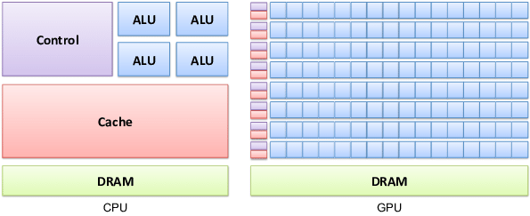
Hardware Parallelism
Vector Architectures & GPUs & Multimedia Instruction Sets
exploit data-level parallelism;
apply a single instruction to a collection of data in parallel;
GPU
optimized for serial tasks
optimized for parallel tasks
Notes:
Vector architectures and GPUs also exploit data-level parallelism; it applies a single instruction to a collection of data in parallel.
https://www.researchgate.net/profile/Ahcene-Bounceur/publication/280852890/figure/fig5/AS:668518232104966@1536398575325/Difference-Between-GPU-and-CPU-Architecture-GPU-architecture-belongs-to-the-family-of.png

Slide 62
Hardware Parallelism
TLP: Thread-Level Parallelism
exploits either DLP or TLP,
in a tightly coupled hardware model
that allows for interaction among parallel threads;
Notes:
On the other hand, thread-level parallelism exploits either data-level parallelism or task-level parallelism.
It aims for tightly coupled hardware model that allows for interaction among parallel threads.
Multi-core processors;

Slide 63
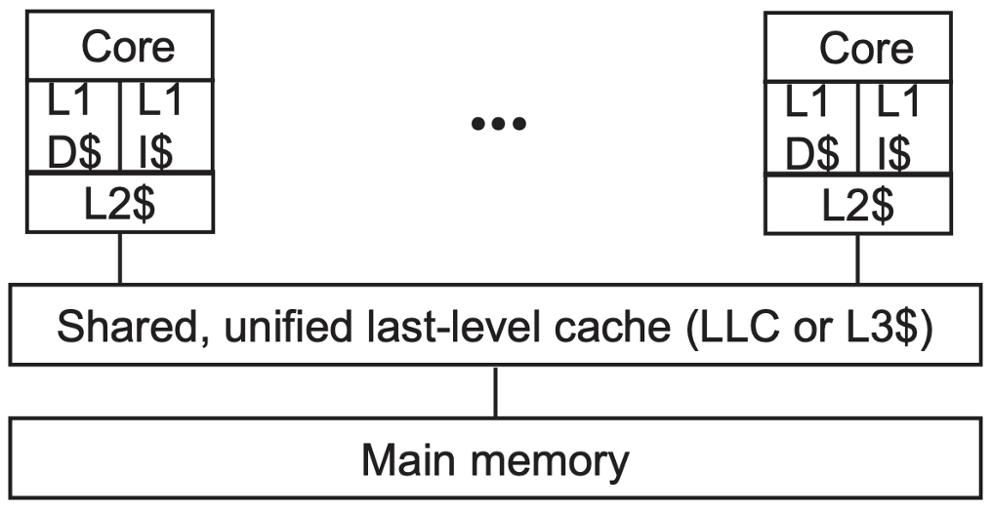
Hardware Parallelism
TLP: Thread-Level Parallelism
exploits either DLP or TLP,
in a tightly coupled hardware model
that allows for interaction among parallel threads;
multi-core
processor
Notes:
On the other hand, thread-level parallelism exploits either data-level parallelism or task-level parallelism.
It aims for tightly coupled hardware model that allows for interaction among parallel threads.
Multi-core processors;

Slide 64
Hardware Parallelism
RLP: Request-Level Parallelism
exploits parallelism among
largely decoupled tasks
specified by the programmer or the OS
Notes:
Finally, request-level parallelism exploits parallelism among largely decoupled tasks specified by the programmer or the operating system.
a typical example is the Google Query-Serving Architecture

Slide 65
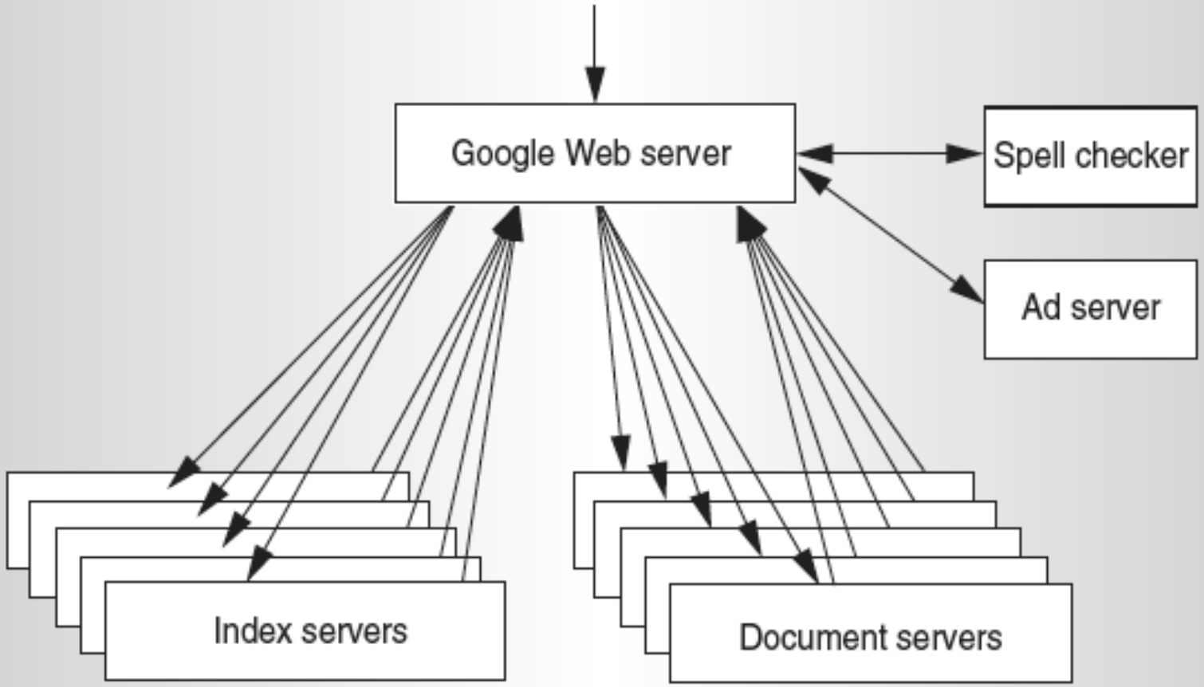
Hardware Parallelism
RLP: Request-Level Parallelism
exploits parallelism among
largely decoupled tasks
specified by the programmer or the OS
Google Query
https://inst.eecs.berkeley.edu/~cs61c/sp12/lectures/02LecSp12MapReducex6.pdf
Notes:
Finally, request-level parallelism exploits parallelism among largely decoupled tasks specified by the programmer or the operating system.
a typical example is the Google Query-Serving Architecture
https://inst.eecs.berkeley.edu/~cs61c/sp12/lectures/02LecSp12MapReducex6.pdf
Hundreds or thousands of requests per second
Such requests are largely independent
Computation can be easily portioned within a request and across different requests

Slide 66
Classes of Parallel Architectures
by Michael Flynn
Single/Multiple Instruction/Data stream
SISD
SIMD
MISD
MIMD
Notes:
According to the number of instruction stream and data stream under use, parallel architectures can be classified into four types.
Each may work on single or multiple instruction streams and single or multiple data streams.

Slide 67
SISD
Single instruction stream,
single data stream
uniprocessor
Exploit instruction-level parallelism
Chapter 3: pipeline, superscalar, speculative execution
Notes:
SISD works on single instruction stream and single data stream.
It can exploit only instruction-level parallelism.
(use techniques such as superscalar and speculative execution)
Superscalar: in which multiple execution units are used to execute multiple instructions in parallel

Slide 68
SIMD
Single instruction stream,
multiple data stream
The same instruction is executed by multiple processors using different data streams.
Exploits data-level parallelism
Data memory for each processor;
whereas a single instruction memory and control processor.
Notes:
SIMD works on single instruction stream and multiple data stream.
Specifically, the same instruction is executed by multiple processors using different data streams. it thus exploits data-level parallelism.
Each processor has a data memory of its own, while all processors share a single instruction memory and control processor, which fetches and dispatches instructions.
::
Chapter 4 covers DLP and three different architectures that exploit it: vector architectures, multimedia extensions to standard instruction sets, and GPUs.

Slide 69
SIMD
Single instruction stream,
multiple data stream
The same instruction is executed by multiple processors using different data streams.
Exploits data-level parallelism Chapter 4: vector architectures, multimedia instruction sets, GPUs
Notes:
SIMD works on single instruction stream and multiple data stream.
Specifically, the same instruction is executed by multiple processors using different data streams. it thus exploits data-level parallelism.
Each processor has a data memory of its own, while all processors share a single instruction memory and control processor, which fetches and dispatches instructions.
::
Chapter 4 covers DLP and three different architectures that exploit it: vector architectures, multimedia extensions to standard instruction sets, and GPUs.

Slide 70
MISD
Multiple instruction streams,
single data stream
hard to exploit data-level parallelism
No commercial multiprocessor of this type yet
Notes:
MISD works on Multiple instruction streams and a single data stream
As you may notice, it’s hard to exploit data-level parallelism for misd, so there’s no such type of commercial multiprocessor yet;

Slide 71
MIMD
Multiple instruction streams,
multiple data streams
Each processor fetches its own instructions and operates on its own data
Exploits task-level parallelism Chapter 5: thread-level parallelism Chapter 6: request-level parallelism
Notes:
MIMD works on multiple instruction streams and multiple data streams.
Each processor fetches its own instructions and operates on its own data.
It exploits task-level parallelism.
Chapter 5 covers tightly coupled MIMD architectures, which exploit thread-level parallelism because multiple cooperating threads operate in parallel. Chapter 6 covers loosely coupled MIMD architectures—specifically, clusters and warehouse-scale computers—that exploit request-level parallelism, where many independent tasks can proceed in parallel naturally with little need for communication or synchronization.

Slide 72
What’s computer architecture?
Notes:
We’ve discussed about computer basics and parallelism it can leverage for fast task execution;
Then what exactly is computer architecture?

Slide 73
Computer Architecture
Instruction Set Design & Implementation
Determine important attributes for a new computer
Maximize performance and energy efficiency while staying within cost, power, and availability constraints
Notes:
The term computer architecture is used to refer only to instruction set design.
The task the computer designer faces is a complex one: determine what attributes are important for a new computer, then design a computer to maximize
performance and energy efficiency while staying within cost, power, and availabil- ity constraints. This task has many aspects, including instruction set design, func- tional organization, logic design, and implementation. The implementation may encompass integrated circuit design, packaging, power, and cooling. Optimizing the design requires familiarity with a very wide range of technologies, from com- pilers and operating systems to logic design and packaging.

Slide 74
What’s instruction set architecture?
Notes:
So first, we need to understand what is instruction set architecture.

Slide 75
Instruction Set Architecture
ISA
programmer-visible instruction set
the boundary between software and hardware
Notes:
Instruction set architecture is called ISA for short.
It’s visible to programmers and serves as the boundary between software and hardware.

Slide 76
7 Dimensions of ISA
Class of ISA
Memory addressing
Addressing modes
Types and sizes of operands
Operations
Control flow instructions
Encoding an ISA
Notes:
Next, we will quickly review the seven dimensions of an ISA.

Slide 77
ISA: Class
Most are general-purpose register architectures with operands of either registers or memory locations
Two popular versions
register-memory ISA: e.g., 80x86
many instructions can access memory
load-store ISA: e.g., ARMv8, RISC-V
only load and store instructions can access memory
Notes:
Most instruction set architectures are general-purpose register architectures.
Their operands are either registers or memory locations.
Tow popular versions of general-purpose register architectures are register-memory ISA and load-store ISA.
80 ex 86 belongs to register-memory ISA. It allows many instructions to access memory.
ARM and MIPS belong to load-store ISA. It allows only load and store instructions to access memory.

Slide 78
ISA: Class
Most are general-purpose register architectures with operands of either registers or memory locations
Two popular versions
register-memory ISA: e.g., 80x86
many instructions can access memory
load-store ISA: e.g., ARMv8, RISC-V
only load and store instructions can access memory
*all ISAs announced since 1985
are load-store
Notes:
All ISAs announced since 1985 are load-store.

Slide 79
ISA: Class
Most are general-purpose register architectures with operands of either registers or memory locations
Two popular versions
register-memory ISA: e.g., 80x86
many instructions can access memory
load-store ISA: e.g., ARMv8, RISC-V
only load and store instructions can access memory
*all ISAs announced since 1985
are load-store
Notes:
Focus more on RISC-V in this edition

Slide 80
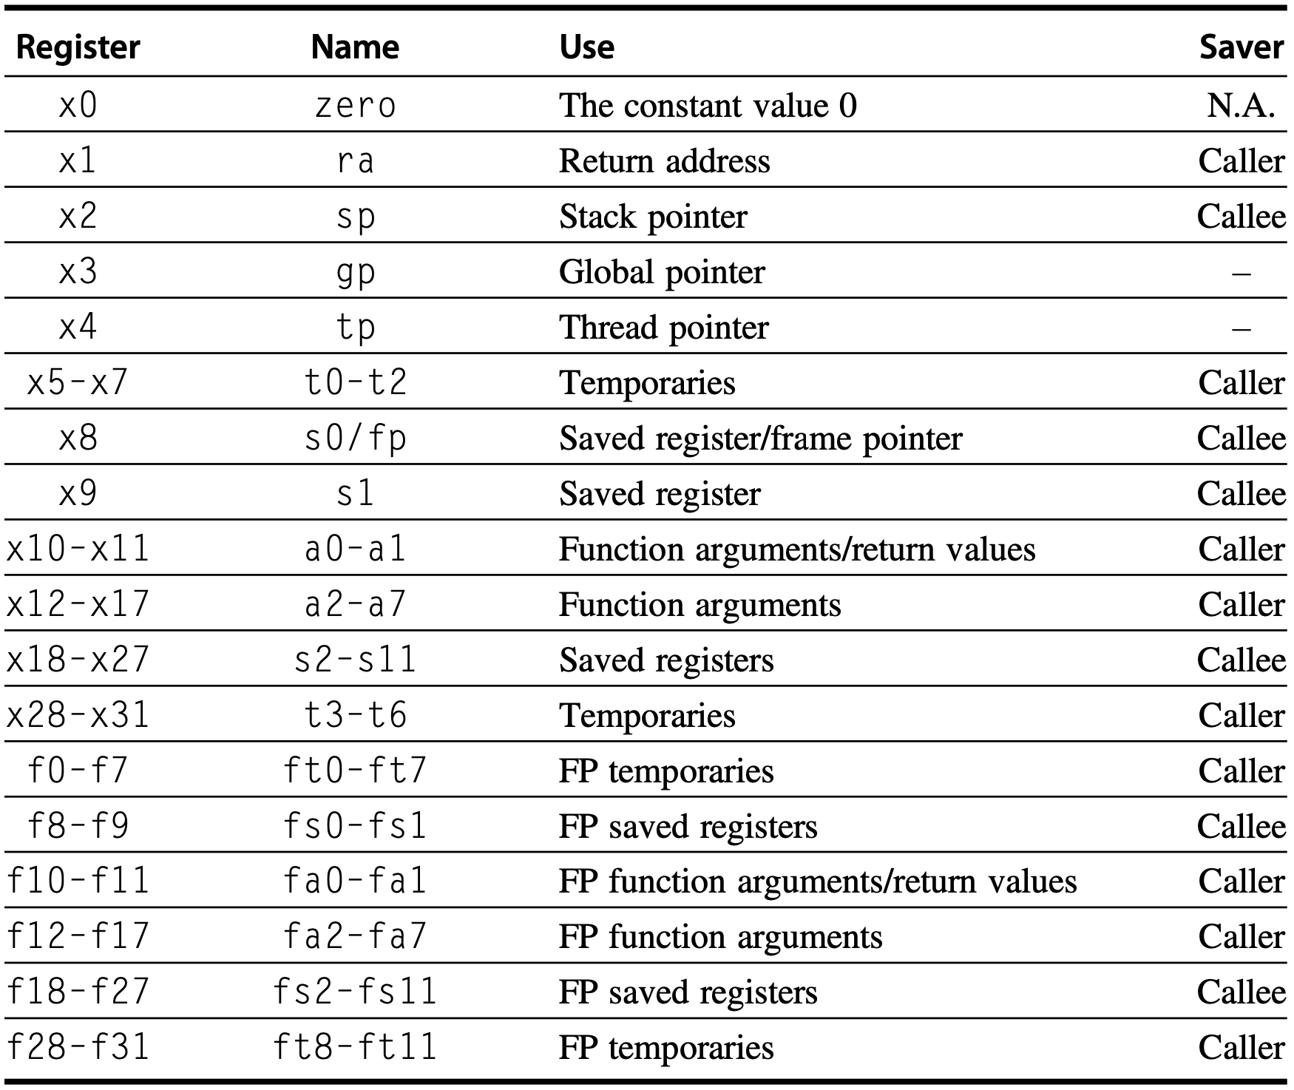
ISA: Class
RISC-V registers
Notes:
Figure1.4 RISC-V registers, names, usage, and calling conventions. In addition to the 32 general-purpose registers (x0–x31), RISC-V has 32 floating-point registers (f0–f31) that can hold either a 32-bit single-precision number or a 64-bit double-precision num- ber. The registers that are preserved across a procedure call are labeled “Callee” saved.

Slide 81
ISA: Memory Addressing
Byte addressing
smallest accessible data unit is one byte
each byte has a unique address
Aligned address: ARMv8
object width: s bytes
address: A
aligned if A mod s = 0
Notes:
Memory addressing is the procedure when an instruction finds its interested data at a certain location in memory.
The smallest unit for how much volume of data can be accessed at one time is one byte.
When storing data in memory, we require that their addresses be aligned.
Given object width s and address A, for its address to be aligned, we should have that A modulo s equals to zero.

Slide 82
ISA: Memory Addressing
Byte addressing
Aligned address: ARMv8
object width: s bytes
address: A
aligned if A mod s = 0
80x86 and RISC-V do not require alignment, albeit alignment yields faster accesses
Notes:
The 80x86 and RISC-V, however, do not require alignment, although accesses are generally faster if operands are aligned.

Slide 83
Why is alignment faster?
Notes:
Then why can address alignment yield faster accesses?

Slide 84
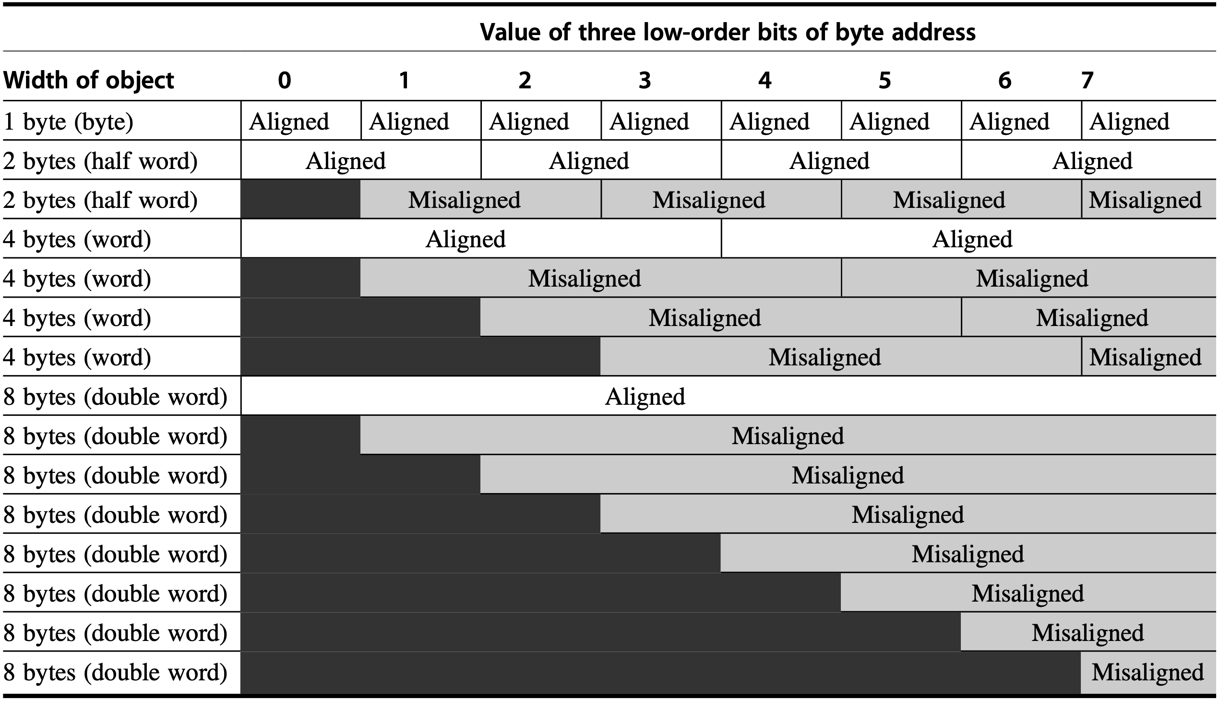
Each misaligned object requires two memory accesses
Notes:
This picture clearly demonstrates that address alignment helps limit memory access times.
When well aligned, requires only one memory access to read one object;
If address is not well aligned, each misaligned object requires two memory accesses to fetch.
(operand width related)
Figure A.5 Aligned and misaligned addresses of byte, half-word, word, and double-word objects for byte- addressed computers. For each misaligned example some objects require two memory accesses to complete. Every aligned object can always complete in one memory access, as long as the memory is as wide as the object. The figure shows the memory organized as 8 bytes wide. The byte offsets that label the columns specify the low-order three bits of the address.
Examples of alignment conventions https://www.youtube.com/watch?v=TtAsN0ptKcw&list=PL0oekSefhQVJdk0hSRu6sZ2teWM740NtL&index=49

Slide 85
Address Alignment
struct s1 {
char c;
int i[2];
double v;
} *p1;
assume 8-byte double objects

Slide 86
Address Alignment
struct s1 {
char c;
int i[2];
double v;
} *p1;
assume 8-byte double objects
3 bytes
c
i[0]
i[1]
4 bytes
v
p1+0
p1+4
p1+8
p1+16
p1+24
assume multiple of 8

Slide 87
Address Alignment
struct s1 {
char c;
int i[2];
double v;
} *p1;
assume 8-byte double objects
struct s1 {
double v;
int i[2];
int c;
} *p2;
3 bytes
c
i[0]
i[1]
4 bytes
v
p1+0
p1+4
p1+8
p1+16
p1+24
v
i[0]
i[1]
c
7 bytes…
p2+0
p2+8
p2+16
p2+24

Slide 88
ISA: Types and Sizes of OPerands
Type | Size in bits
ASCII character | 8
Unicode character Half word | 16
Integer word | 32
Double word Long integer | 64
IEEE 754 floating point – single precision | 32
IEEE 754 floating point – double precision | 64
Floating point – extended double precision | 80
Notes:
(operand width/size related)
Here’s an overview of types and sizes of instruction operands.

Slide 89
ISA: Addressing Modes
Specify the location of operands
registers, constants, or the address of a memory object:
RISC-V:
Register, Immediate, Displacement
constant
addi x1, x1, 0x10
register + constant
lw x1, 100(x2)
Notes:
(how to find/access the desired operand)
An instruction has three addressing modes for it to specify the address of a memory object as one of its operands.
For RISC-V, the operand could be a register, an immediate, or a displacement.
For register, the operand is just the name/alias of the register.
for immediate, it’s a constant that can be directly used as an operand.
For displacement, it specifies a register in addition to a constant, then we need to add the constant to the value stored in the register, the result is the corresponding memory address.

Slide 90
ISA: Addressing Modes
RISC-V Register Naming
Notes:
Figure1.4 RISC-V registers, names, usage, and calling conventions. In addition to the 32 general-purpose registers (x0–x31), RISC-V has 32 floating-point registers (f0–f31) that can hold either a 32-bit single-precision number or a 64-bit double-precision number. The registers that are preserved across a procedure call are labeled “Callee” saved.

Slide 91
ISA: Addressing Modes
Specify the location of operands
registers, constants, or the address of a memory object:
80x86:
Register, Immediate, Displacement
constant
Add R4, #3
register + constant
Add R4, 100(R1)
Notes:
(how to find/access the desired operand)
An instruction has three addressing modes for it to specify the address of a memory object as one of its operands.
For RISC-V, the operand could be a register, an immediate, or a displacement.
For register, the operand is just the name/alias of the register.
for immediate, it’s a constant that can be directly used as an operand.
For displacement, it specifies a register in addition to a constant, then we need to add the constant to the value stored in the register, the result is the corresponding memory address.

Slide 92
ISA: Addressing Modes
Specify the location of operands
registers, constants, or the address of a memory object:
80x86: 3+ variations of displacement
Register, Immediate, Displacement
no register (absolute)
Add R1, (1001)
Regs[R1] ← Regs[R1] + Mem[1001]
Notes:
https://www.geeksforgeeks.org/addressing-modes-8086-microprocessor/
The 80x86 supports those three modes, plus three variations of displacement:
No registers (absolute)
Two registers (based indexed with displacement)
Two registers where one register is multiplied by the size of the operand in bytes (based with scaled index and displacement)

Slide 93
ISA: Addressing Modes
Specify the location of operands
registers, constants, or the address of a memory object:
80x86: 3+ variations of displacement
Register, Immediate, Displacement
two registers (based indexed with disp)
Add R3, 1000(R1+R2)
Mem[1000+Regs[R1]+Regs[R2]]*
Notes:
The 80x86 supports those three modes, plus three variations of displacement:
No registers (absolute)
Two registers (based indexed with displacement): In this type of addressing mode the effective address is the sum of index register, base register and displacement.
Two registers where one register is multiplied by the size of the operand in bytes (based with scaled index and displacement)

Slide 94
ISA: Addressing Modes
Specify the location of operands
registers, constants, or the address of a memory object:
80x86: 3+ variations of displacement
Register, Immediate, Displacement
two registers (based with scaled & disp)
Add R1, 100(R2)[R3]
Mem[100+Regs[R2]+Regs[R3]*d]
given d-byte operand
Notes:
The 80x86 supports those three modes, plus three variations of displacement:
No registers (absolute)
Two registers (based indexed with displacement)
Two registers where one register is multiplied by the size of the operand in bytes (based with scaled index and displacement)

Slide 95
ISA: Addressing Modes
Specify the location of operands
registers, constants, or the address of a memory object:
80x86: still some more w/o disp
Register, Immediate, Displacement
register indirect
Add R4, (R1)
Mem[Regs[R1]]
Notes:
The 80x86 has some more addressing modes like the previous modes without the displacement field:
Register indirect: memory locations stored in a register; used when accessing using a pointer or a computed address;
Indexed:
Based with scaled index:

Slide 96
ISA: Addressing Modes
Specify the location of operands
registers, constants, or the address of a memory object:
80x86: still some more w/o disp
Register, Immediate, Displacement
indexed
Add R3, (R1+R2)
Mem[Regs[R1]+Regs[R2]]
Notes:
The 80x86 has some more addressing modes like the previous modes without the displacement field:
Register indirect: memory locations stored in a register; used when accessing using a pointer or a computed address;
Indexed: sometimes useful in array addressing R1=base of array and R2=index amount;
Based with scaled index:

Slide 97
ISA: Addressing Modes
Specify the location of operands
registers, constants, or the address of a memory object:
80x86: 3+ variations of displacement
Register, Immediate, Displacement
based with scaled index
Add R1, (R2)[R3]
Mem[Regs[R2]+Regs[R3]*d]100+
given d-byte operand 100+
Notes:
The 80x86 supports those three modes, plus three variations of displacement:
No registers (absolute)
Two registers (based indexed with displacement)
Two registers where one register is multiplied by the size of the operand in bytes (based with scaled index and displacement)

Slide 98
ISA: Addressing Modes
Specify the location of operands
registers, constants, or the address of a memory object:
ARMv8:
Register, Immediate, Displacement
PC-relative addressing
beq $0, $5, Label1
PC + offset*
*left-shifted by 2 and sign-extended
Notes:
ARMv8 has the three addressing modes (register, immediate, displacement) plus:
PC-relative addressing: The PC-relative addressing mode can be used to load a register with a value stored in program memory a short distance away from the current instruction. It can be seen as a special case of the "base plus offset" addressing mode, one that selects the program counter (PC) as the "base register". / PC-relative addressing is used for conditional branches. The address is the sum of the program counter and a constant in the instruction (beq: Branch if EQual)
The sum of two registers:
The sum of two registers where one register is multiplied by the size of the operand in bytes:
Autoincrement addressing:
Autodecrement addressing:

Slide 99
ISA: Addressing Modes
Specify the location of operands
registers, constants, or the address of a memory object:
ARMv8:
Register, Immediate, Displacement
sum of two registers
Add R3, (R1+R2)
Notes:
ARMv8 has the three addressing modes (register, immediate, displacement) plus:
PC-relative addressing: The PC-relative addressing mode can be used to load a register with a value stored in program memory a short distance away from the current instruction. It can be seen as a special case of the "base plus offset" addressing mode, one that selects the program counter (PC) as the "base register". / PC-relative addressing is used for conditional branches. The address is the sum of the program counter and a constant in the instruction
The sum of two registers: as it is; as in example
The sum of two registers where one register is multiplied by the size of the operand in bytes:
Autoincrement addressing:
Autodecrement addressing:

Slide 100
ISA: Addressing Modes
Specify the location of operands
registers, constants, or the address of a memory object:
ARMv8:
Register, Immediate, Displacement
scaled index addressing
Add R1, (R2)[R3]
Mem[Regs[R2]+Regs[R3]*d]
given d-byte operand
Notes:
ARMv8 has the three addressing modes (register, immediate, displacement) plus:
PC-relative addressing: The PC-relative addressing mode can be used to load a register with a value stored in program memory a short distance away from the current instruction. It can be seen as a special case of the "base plus offset" addressing mode, one that selects the program counter (PC) as the "base register". / PC-relative addressing is used for conditional branches. The address is the sum of the program counter and a constant in the instruction
The sum of two registers: as in example
The sum of two registers where one register is multiplied by the size of the operand in bytes: as in example
Autoincrement addressing:
Autodecrement addressing:

Slide 101
ISA: Addressing Modes
Specify the location of operands
registers, constants, or the address of a memory object:
ARMv8:
Register, Immediate, Displacement
autoincrement addressing
Add R1, (R2)+
Mem[Regs[R2]]
Regs[R2]← Regs[R2]+d
Notes:
ARMv8 has the three addressing modes (register, immediate, displacement) plus:
PC-relative addressing: The PC-relative addressing mode can be used to load a register with a value stored in program memory a short distance away from the current instruction. It can be seen as a special case of the "base plus offset" addressing mode, one that selects the program counter (PC) as the "base register". / PC-relative addressing is used for conditional branches. The address is the sum of the program counter and a constant in the instruction
The sum of two registers: as in example
The sum of two registers where one register is multiplied by the size of the operand in bytes: as in example
Autoincrement addressing: useful for stepping through arrays within a loop. R2 points to the start of an array; each reference increments R2 by size of an element, d;
Autodecrement addressing:

Slide 102
ISA: Addressing Modes
Specify the location of operands
registers, constants, or the address of a memory object:
ARMv8:
Register, Immediate, Displacement
autodecrement addressing
Add R1, -(R2)
Regs[R2]← Regs[R2]-d
Mem[Regs[R2]]
Notes:
ARMv8 has the three addressing modes (register, immediate, displacement) plus:
PC-relative addressing: The PC-relative addressing mode can be used to load a register with a value stored in program memory a short distance away from the current instruction. It can be seen as a special case of the "base plus offset" addressing mode, one that selects the program counter (PC) as the "base register". / PC-relative addressing is used for conditional branches. The address is the sum of the program counter and a constant in the instruction
The sum of two registers: as in example
The sum of two registers where one register is multiplied by the size of the operand in bytes: as in example
Autoincrement addressing: useful for stepping through arrays within a loop. R2 points to the start of an array; each reference increments R2 by size of an element, d;
Autodecrement addressing: same use as autoincrement. Autodecrement/-increment can also act as push/pop to implement a stack.

Slide 103
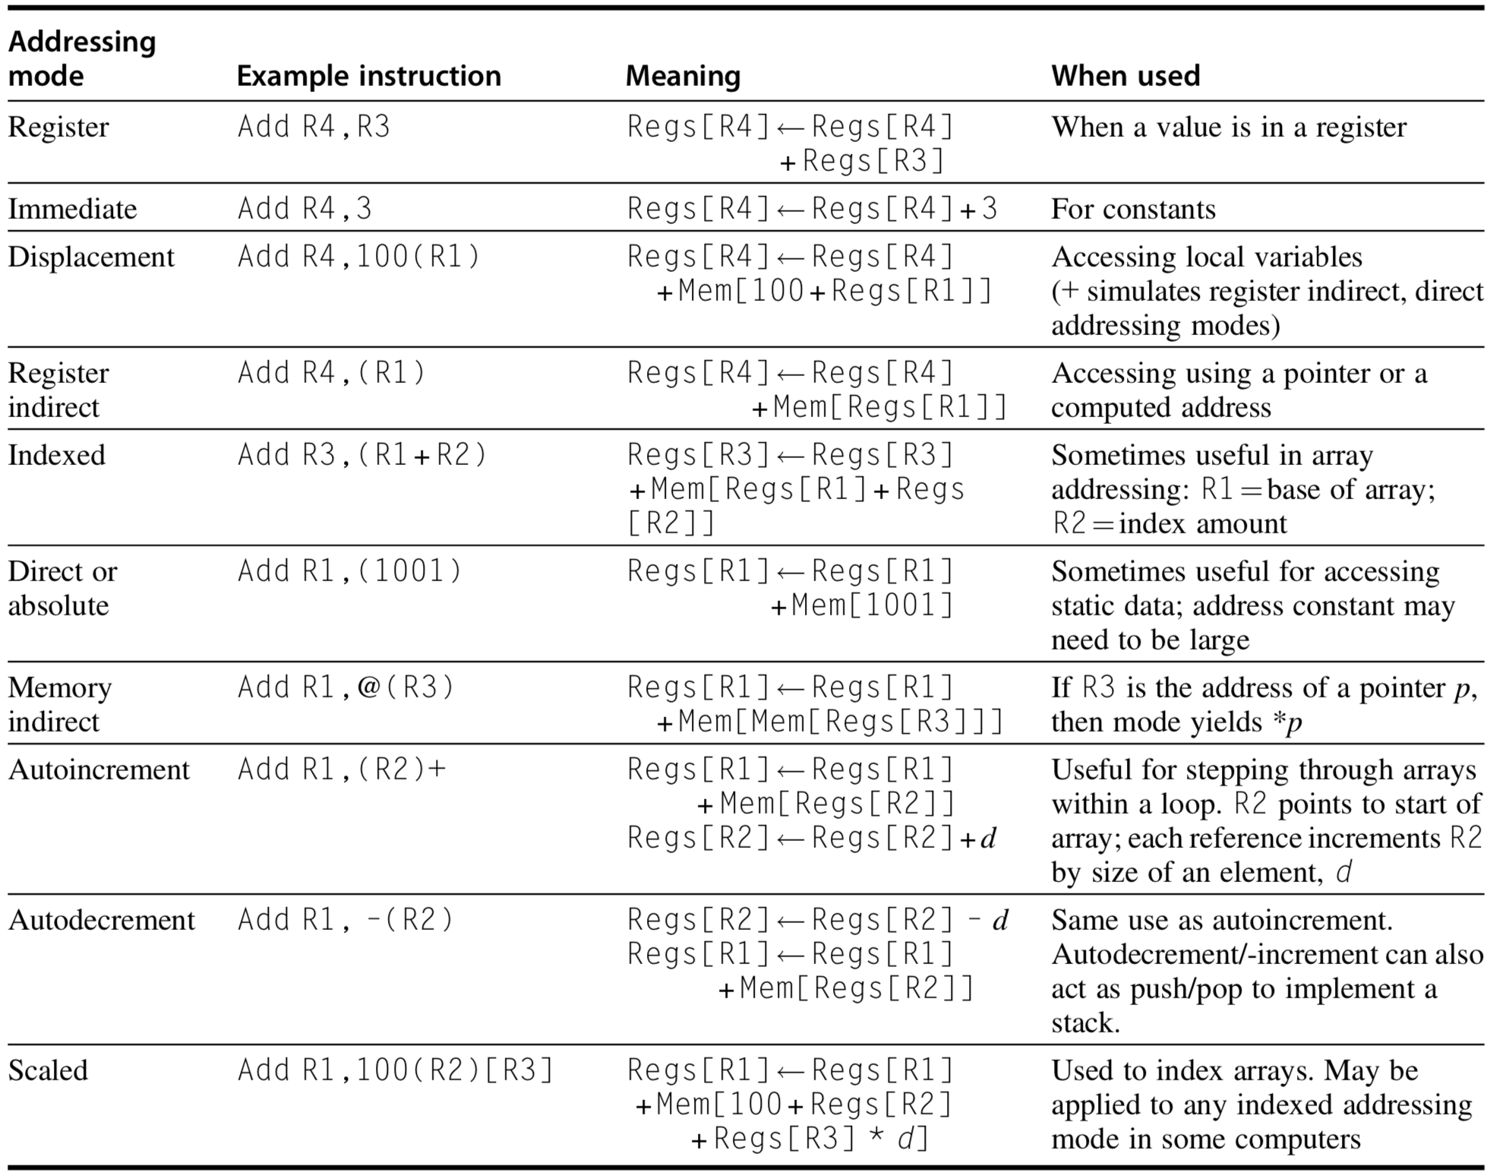
Addressing Modes
Notes:
This table summarizes different addressing modes and their meanings.
For example,
FigureA.6 Selection of addressing modes with examples, meaning, and usage. In autoincrement/-decrementand scaled addressing modes, the variable d designates the size of the data item being accessed (i.e., whether the instruc- tion is accessing 1, 2, 4, or 8 bytes). These addressing modes are only useful when the elements being accessed are adjacent in memory. RISC computers use displacement addressing to simulate register indirect with 0 for the address and to simulate direct addressing using 0 in the base register. In our measurements, we use the first name shown for each mode. The extensions to C used as hardware descriptions are defined on page A.38.

Slide 104
ISA: Operations
Four general categories:
data transfer
arithmetic/logical
control
floating point
Notes:
With an instruction, we could achieve one of the following four categories of operations:
They are data transfer operation, arithmetic/logical operation, control operation, floating point operation;

Slide 105
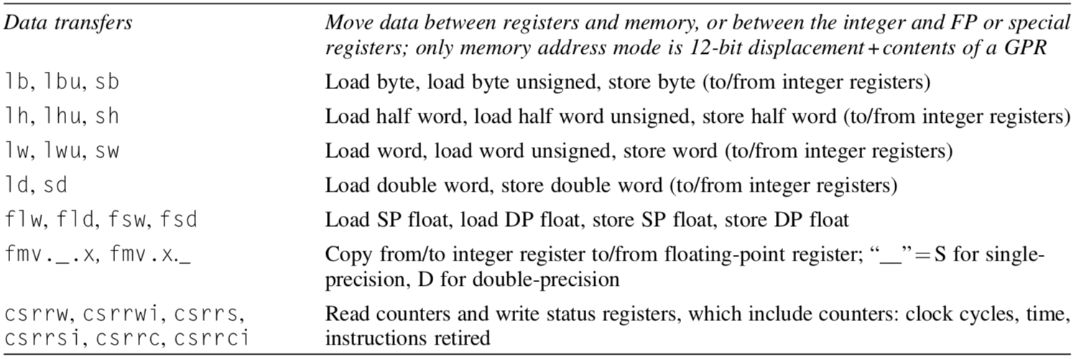
RISC-V Operations
Data Transfer
Notes:
Figure1.5 Subset of the instructions in RISC-V. RISC-V has a base set of instructions (R64I) and offers optional extensions: multiply-divide (RVM), single-precision floating point (RVF), double-precision floating point (RVD). This figure includes RVM and the next one shows RVF and RVD. Appendix A gives much more detail on RISC-V.

Slide 106
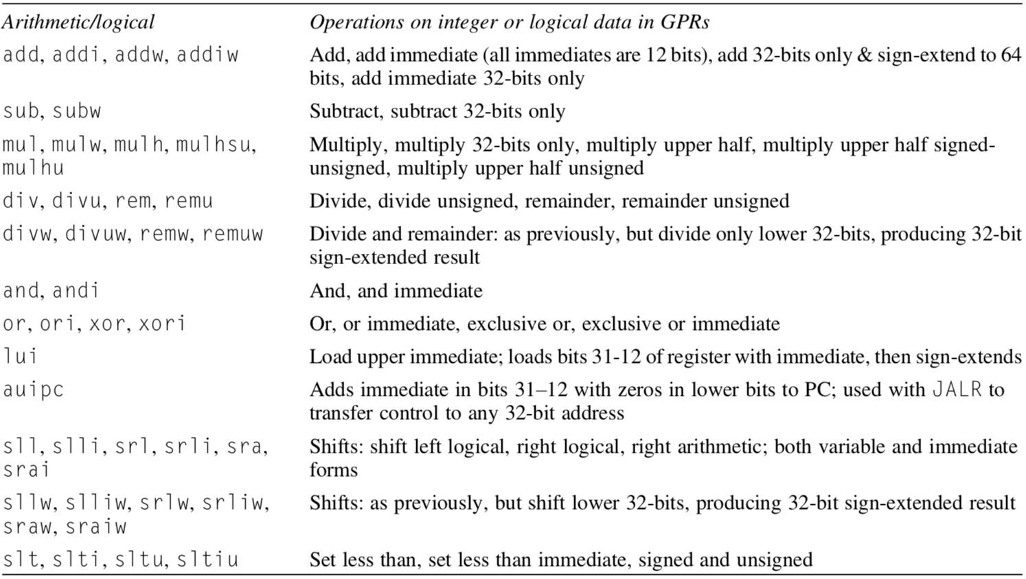
RISC-V Operations
Arithmetic/Logical

Slide 107
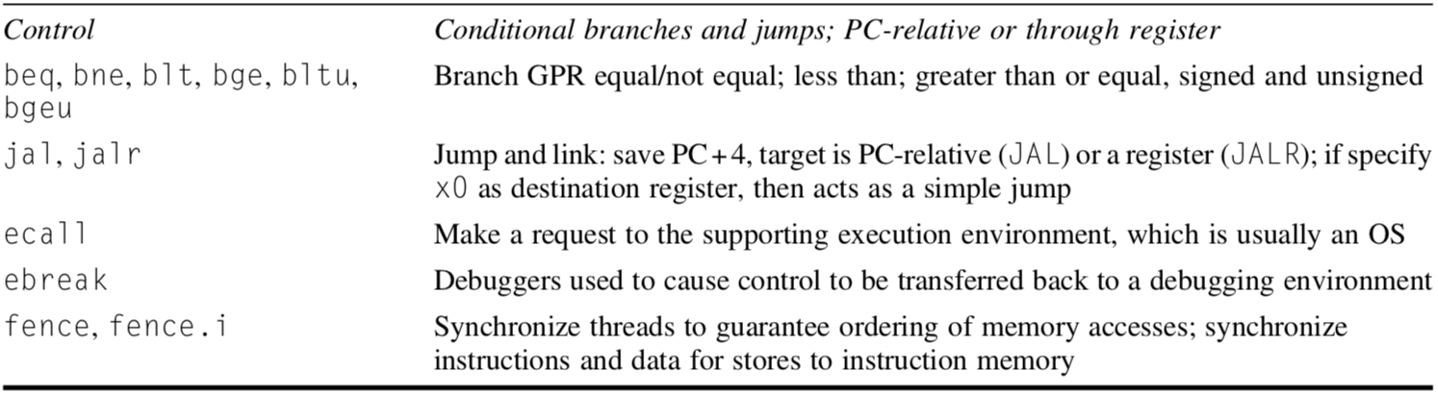
RISC-V Operations
Control

Slide 108
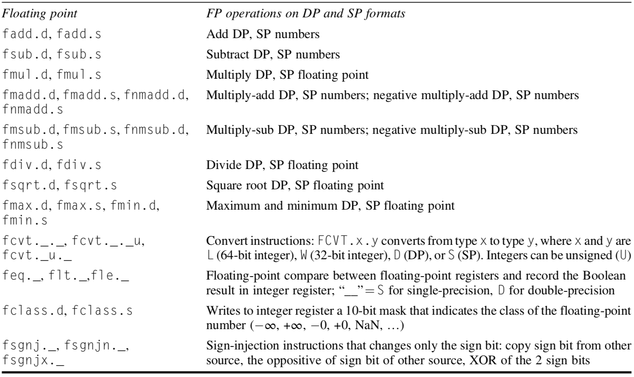
RISC-V Operations
Floating point
Notes:
Figure 1.6 Floating point instructions for RISC-V. RISC-V has a base set of instructions (R64I) and offers optional extensions for single-precision floating point (RVF) and double-precision floating point (RVD). SP 1⁄4 single precision; DP1⁄4double precision.

Slide 109
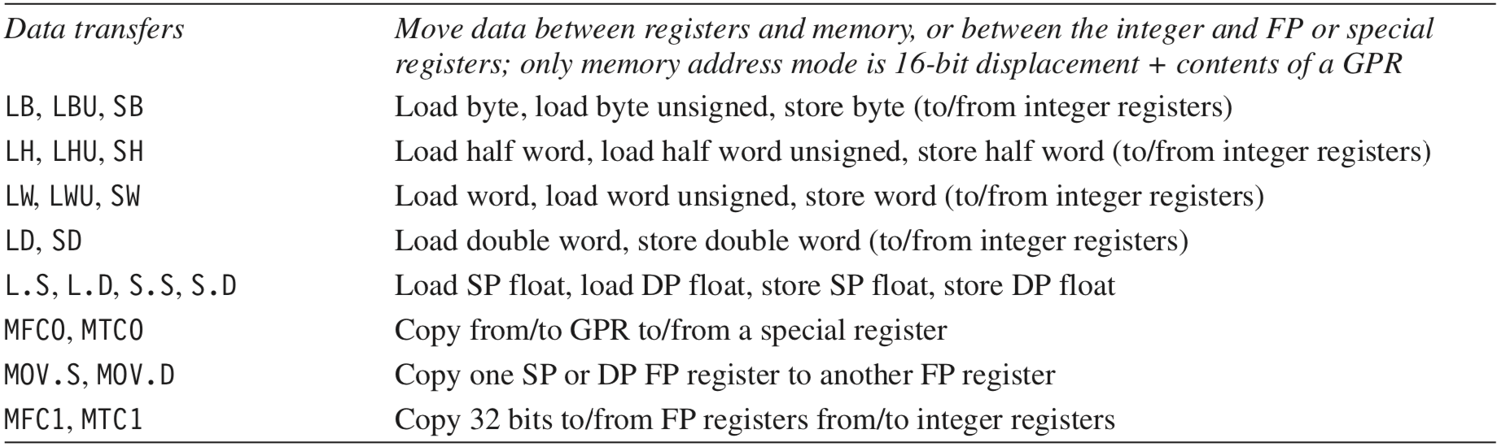
MIPS64 Operations
Data transfer
Notes:
The tables list example instructions of each operation type.

Slide 110
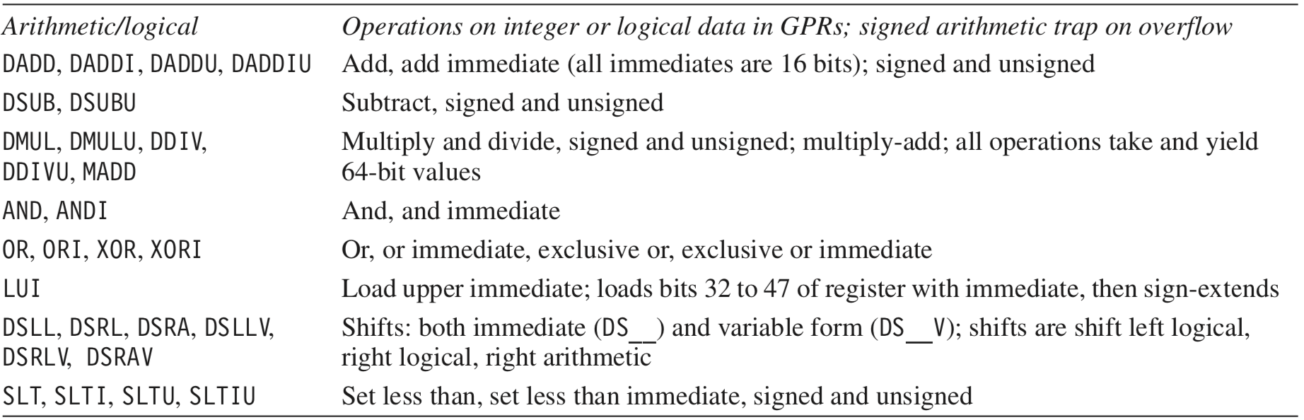
MIPS64 Operations
Arithmetic/Logical

Slide 111
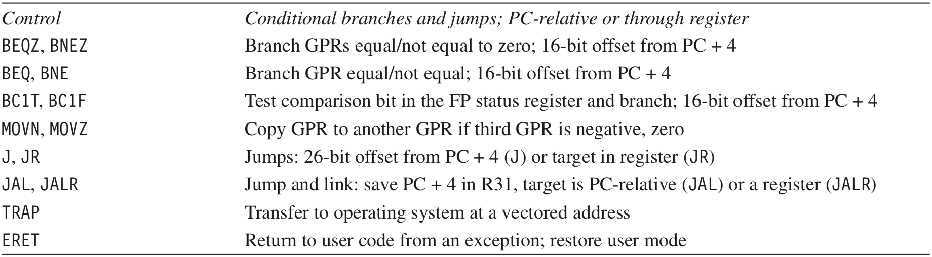
MIPS64 Operations
Control

Slide 112
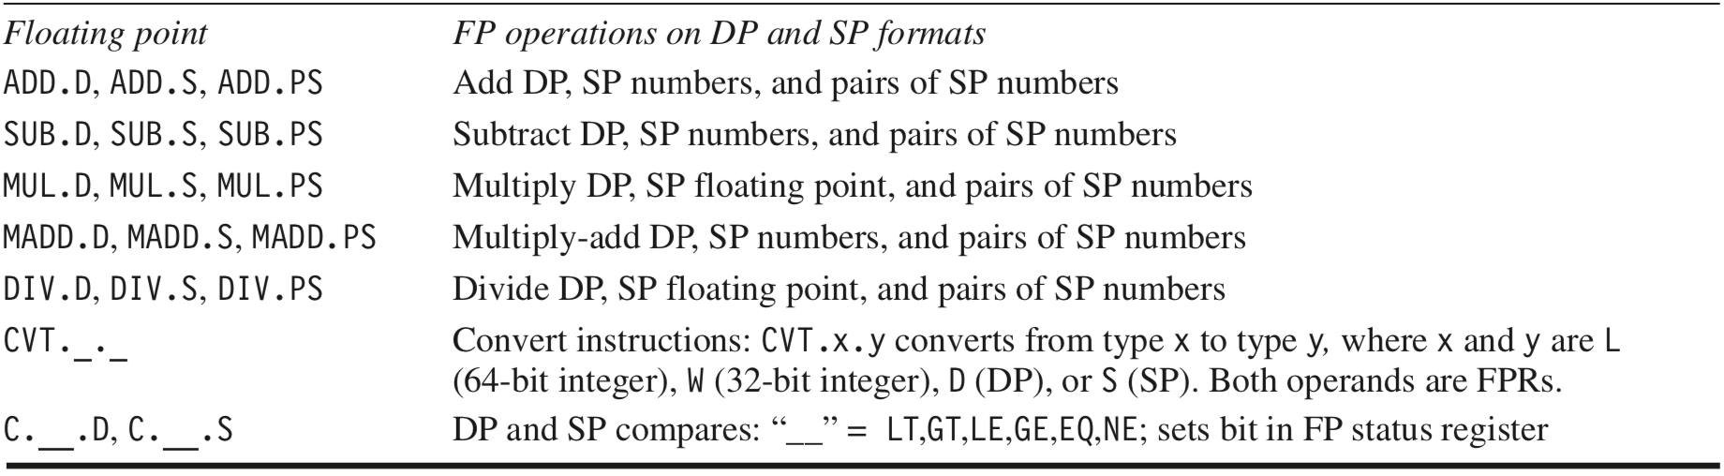
MIPS64 Operations
Floating point

Slide 113
80x86 Operations
Integer
Notes:
x86 architecture has a register-memory ISA where many instructions can access the memory directly.

Slide 114
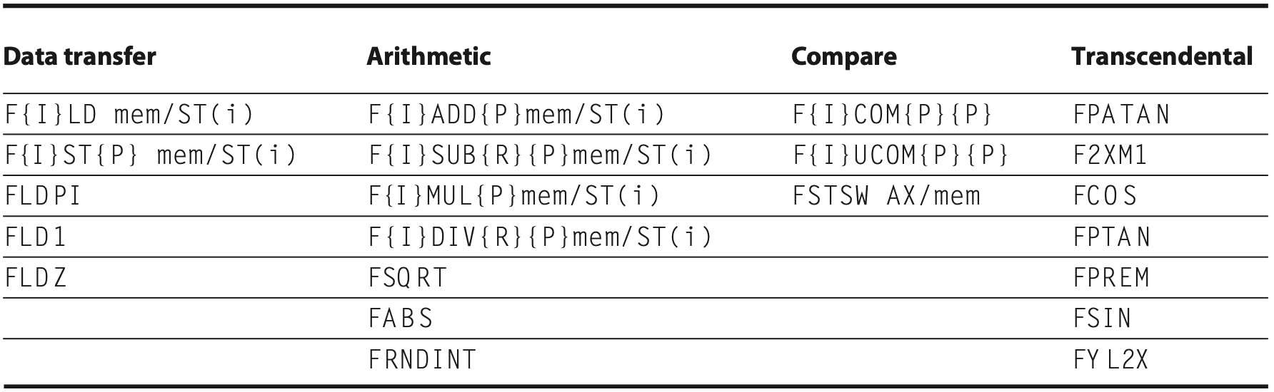
80x86 Operations
Floating point
Notes:
Figure K.35 The floating-point instructions of the 80x86. The first column shows the data transfer instructions, which move data to memory or to one of the registers below the top of the stack. The last three operations push constants on the stack: pi, 1.0, and 0.0. The second column contains the arithmetic operations described above. Note that the last three operate only on the top of stack. The third column is the compare instructions. Since there are no special floating-point branch instructions, the result of the compare must be transferred to the integer CPU via the FSTSW instruction, either into the AX register or into memory, followed by an SAHF instruction to set the condition codes. The floating-point comparison can then be tested using integer branch instructions. The final column gives the higher-level floating-point operations.

Slide 115
ISA: Control Flow Instructions
Types:
conditional branches
unconditional jumps
procedure calls
returns
PC-relative addressing: Branch address = add an address field to PC (program counter)
Notes:
Control instructions also have various types;
All of them use PC-relative addressing, where the branch address is specified by an address field that is added to the PC.
We’ll discuss more about them in later lecture sessions.

Slide 116
ISA: Encoding an ISA
Fixed length
ARMv8, MIPS, RISC-V
32 bits
Variable length
80x86
1~18 bytes
Notes:
As we mentioned, instructions should be encoded in a format understandable to computer hardware, right?
Here are various possible types of instruction formats.
Again, we’ll detail them in later chapters.
R type: rs, rt – the first and second operand; rd – destination register
MIPS reference sheet: https://inst.eecs.berkeley.edu/~cs61c/resources/MIPS_help.html
http://en.wikipedia.org/wiki/MIPS_architecture

Slide 117
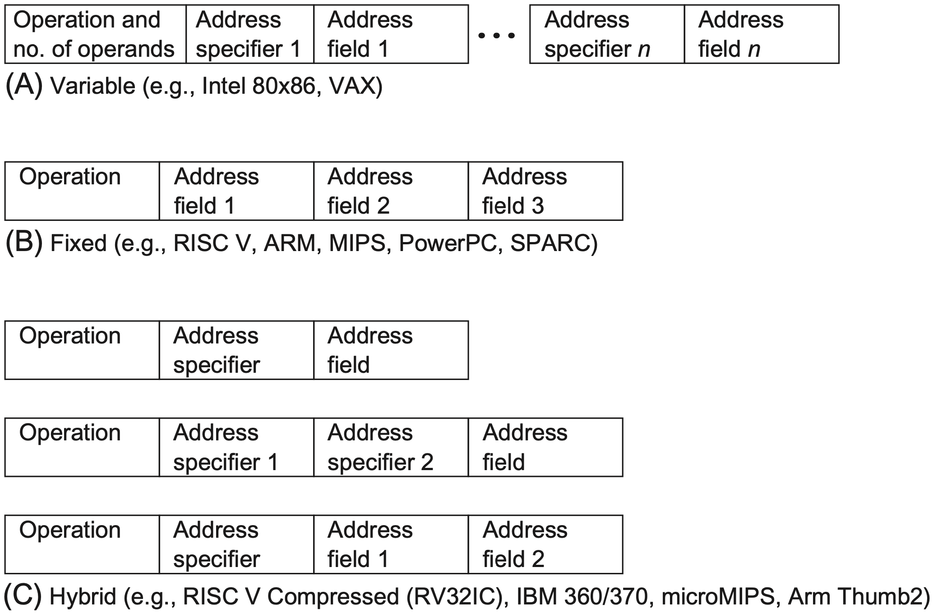
ISA: Encoding an ISA
Notes:
Figure A.18 Three basic variations in instruction encoding: variable length, fixed length, and hybrid. The variable format can support any number of operands, with each address specifier determining the addressing mode and the length of the spec- ifier for that operand. It generally enables the smallest code representation, because unused fields need not be included. The fixed format always has the same number of operands, with the addressing modes (if options exist) specified as part of the opcode. It generally results in the largest code size. Although the fields tend not to vary in their location, they will be used for different purposes by different instruc- tions. The hybrid approach has multiple formats specified by the opcode, adding one or two fields to specify the addressing mode and one or two fields to specify the operand address.

Slide 118
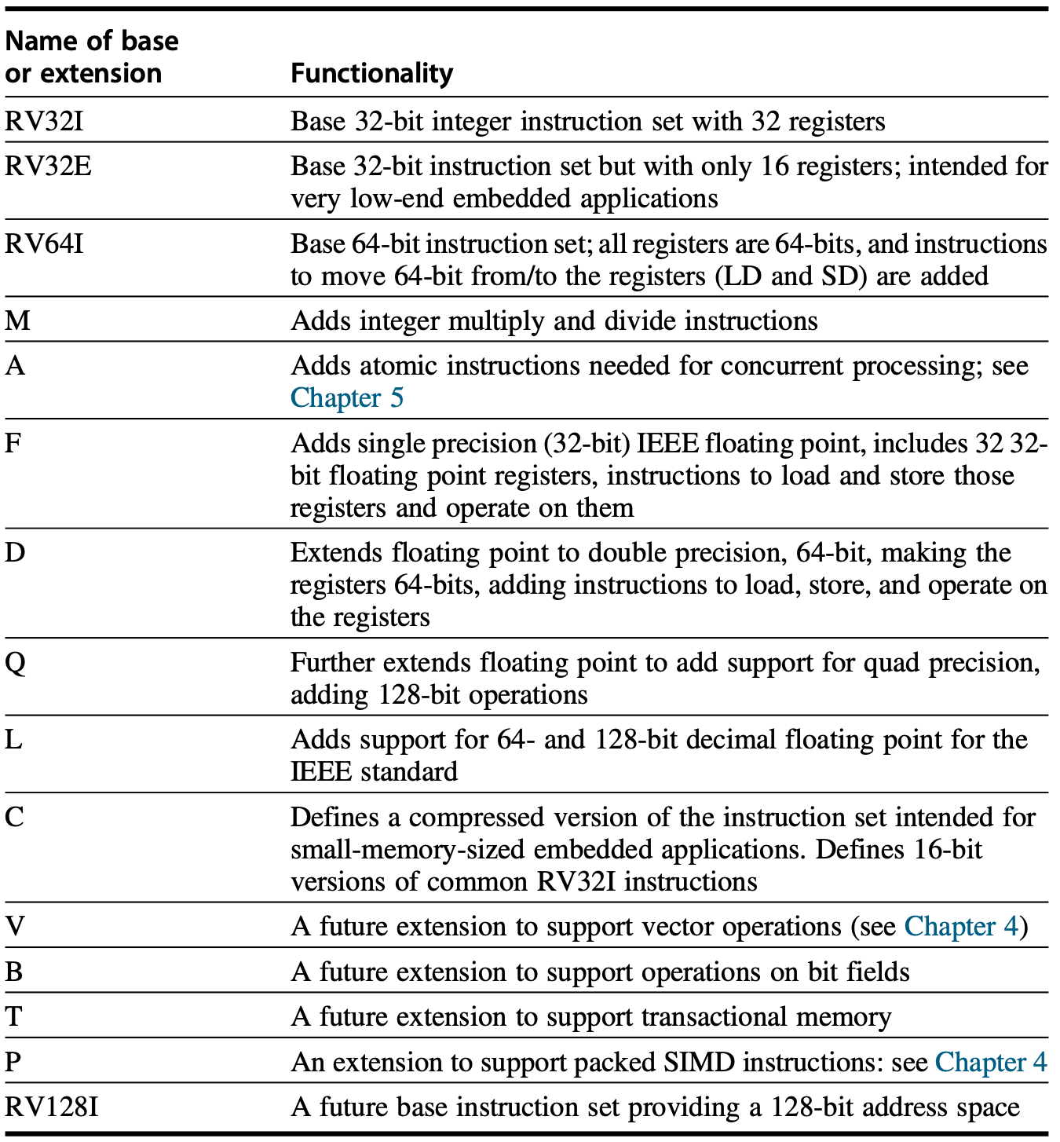
RISC-V
three base instruction sets
Notes:
Appendix A.9

Slide 119
RISC-V
three base instruction sets
RV64I
Notes:
Appendix A.9

Slide 120
RISC-V
three base instruction sets
RV64IMAFD
Notes:
Appendix A.9

Slide 121
RISC-V
three base instruction sets
RV64IMAFD → RV64G
Notes:
Appendix A.9

Slide 122
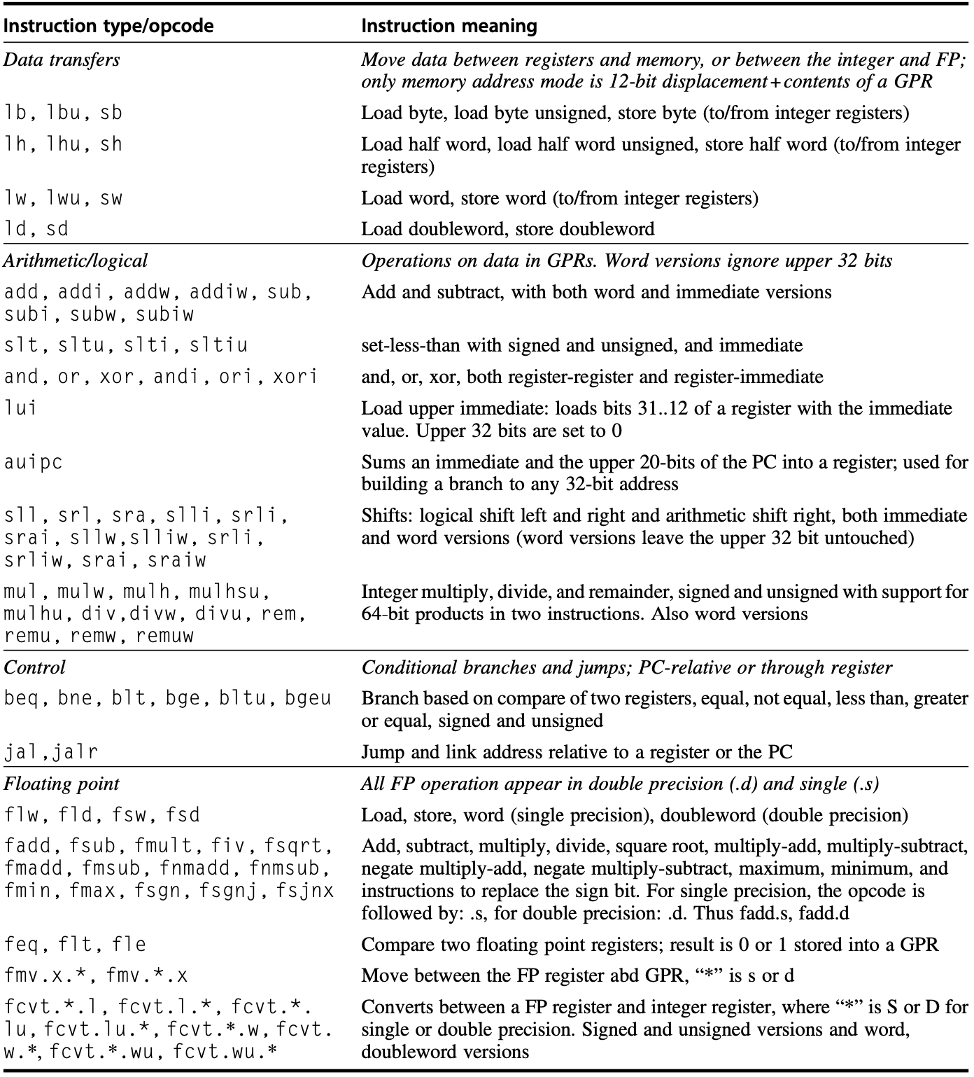
RISC-V
RV64G instructions
Notes:
Appendix A.9

Slide 123
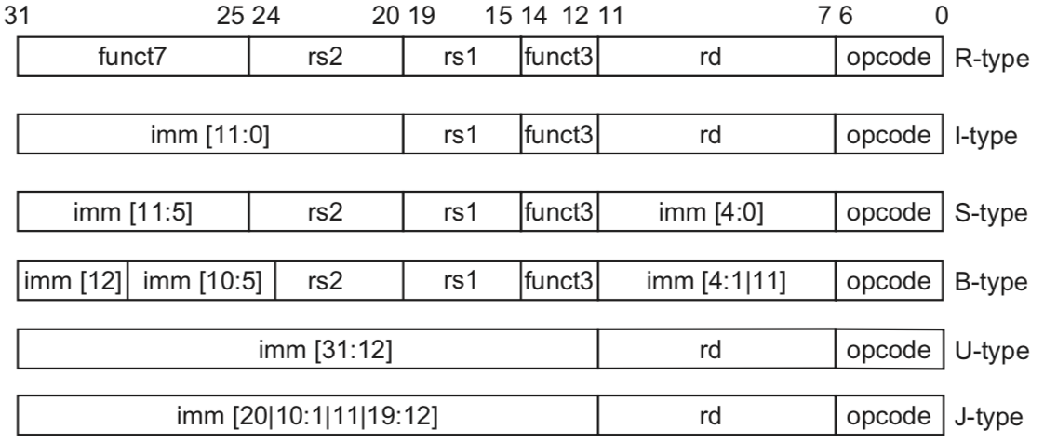
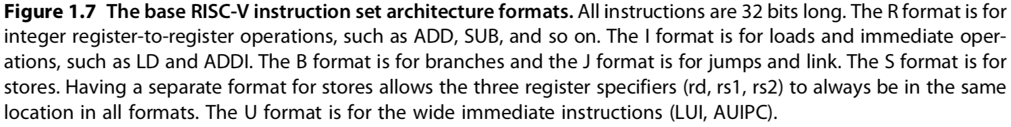
RISC-V Encoding
Notes:
RISC-V ISA encoding;
Might discuss them in later chapters;
Figure1.7 The base RISC-V instruction set architecture formats. All instructions are 32 bits long.
The R format is for integer register-to-register operations, such as ADD, SUB, and so on.
The I format is for loads and immediate oper- ations, such as LD and ADDI.
The B format is for branches and the J format is for jumps and link.
The S format is for stores. Having a separate format for stores allows the three register specifiers (rd, rs1, rs2) to always be in the same location in all formats.
The U format is for the wide immediate instructions (LUI, AUIPC).
There are two variations among these formata, called SB and UJ (B and J) formats
They deal with a slightly different treatment for immediate fields.

Slide 124
RISC-V Encoding
B/J are variations of S/U with slightly different imm
Notes:
RISC-V ISA encoding;
Might discuss them in later chapters;
Figure1.7 The base RISC-V instruction set architecture formats. All instructions are 32 bits long.
The R format is for integer register-to-register operations, such as ADD, SUB, and so on.
The I format is for loads and immediate oper- ations, such as LD and ADDI.
The B format is for branches and the J format is for jumps and link.
The S format is for stores. Having a separate format for stores allows the three register specifiers (rd, rs1, rs2) to always be in the same location in all formats.
The U format is for the wide immediate instructions (LUI, AUIPC).
There are two variations among these formata, called SB and UJ (B and J) formats
They deal with a slightly different treatment for immediate fields.

Slide 125
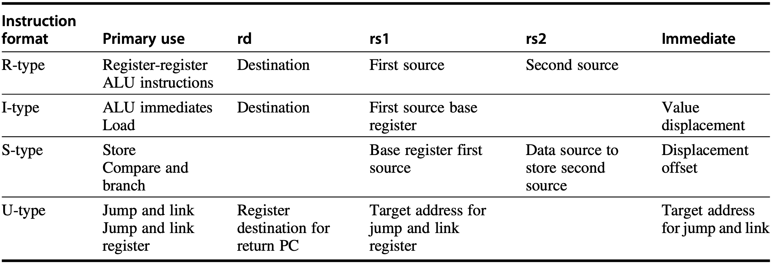
RISC-V Fields
opcode
Notes:
Figure A.24 The use of instruction fields for each instruction type. Primary use shows the major instructions that use the format. A blank indicates that the corresponding field is not present in this instruction type. The I-format is used for both loads and ALU immediates, with the 12-bit immediate holding either the value for an immediate or the displacement for a load. Similarly, the S-format encodes both store instructions (where the first source register is the base register and the second contains the register source for the value to store) and compare and branch instructions (where the register fields contain the sources to compare and the immediate field specifies the offset of the branch target). There are actually two other formats: SB and UJ that follow the same basic organization as S and J, but slightly modify the interpretation of the immediate fields.

Slide 126
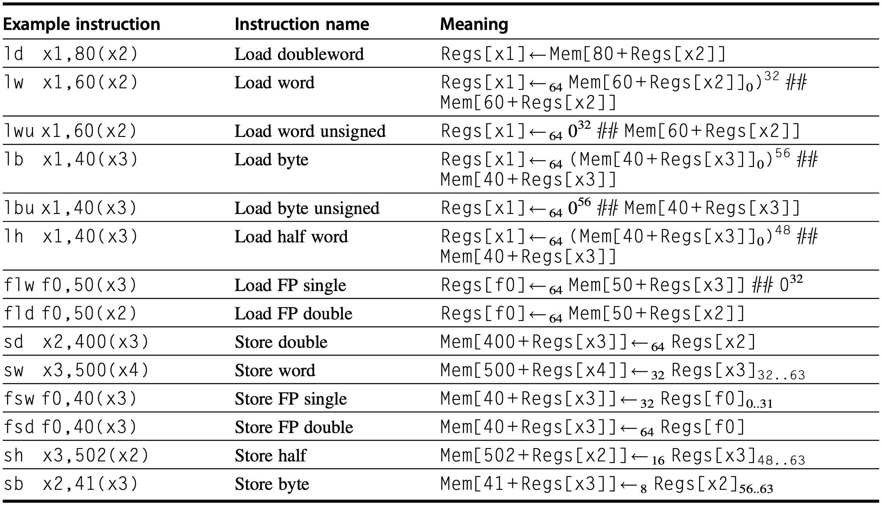
Data Transfer
Notes:
Figure A.25 The load and store instructions in RISC-V. Loads shorter than 64 bits are available in both sign- extended and zero-extended forms. All memory references use a single addressing mode. Of course, both loads and stores are available for all the data types shown. Because RV64G supports double precision floating point, all single precision floating point loads must be aligned in the FP register, which are 64-bits wide.

Slide 127
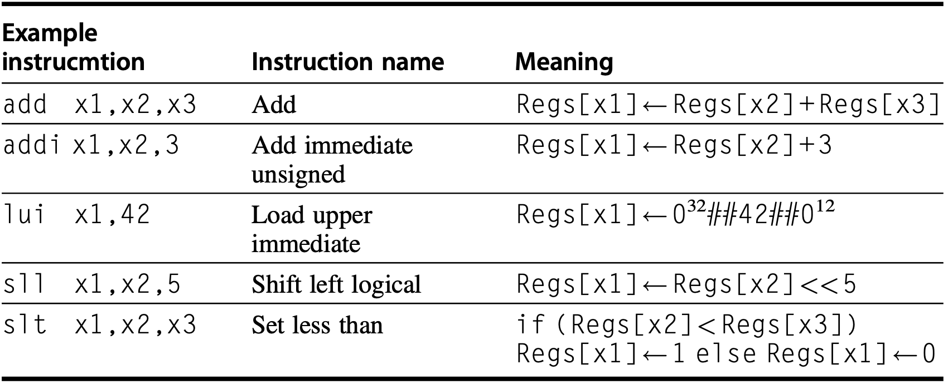
ALU
Notes:
Figure A.26 The basic ALU instructions in RISC-V are available both with register- register operands and with one immediate operand. LUI uses the U-format that employs the rs1 field as part of the immediate, yielding a 20-bit immediate.
The operation LUI (load upper immediate) loads bits 12–31 of a register, sign- extends the immediate field to the upper 32-bits, and sets the low-order 12-bits of the register to 0. LUI allows a 32-bit constant to be built in two instructions, or a data transfer using any constant 32-bit address in one extra instruction.

Slide 128
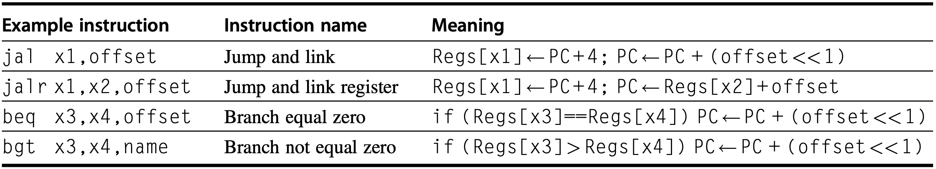
Control Flow
Jump
Branch
Notes:
Figure A.27 Typical control flow instructions in RISC-V. All control instructions, except jumps to an address in a register, are PC-relative.
Control is handled through a set of jumps and a set of branches, and Figure A.27 gives some typical branch and jump instructions.

Slide 129
Control Flow
Jump
unconditional transfers
store the link (i.e., address of the instruction sequentially following the jump instruction) in destination register
Notes:
Figure A.27 Typical control flow instructions in RISC-V. All control instructions, except jumps to an address in a register, are PC-relative.
The two jump instructions (jump and link and jump and link register) are unconditional transfers and always store the “link,” which is the address of the instruction sequentially following the jump instruction, in the register specified by the rd field. In the event that the link address is not needed, the rd field can simply be set to x0, which results in a typical uncon- ditional jump. The two jump instructions are differentiated by whether the address is computed by adding an immediate field to the PC or by adding the immediate field to the contents of a register. The offset is interpreted as a half word offset for compatibility with the compressed instruction set, R64C, which includes 16-bit instructions.

Slide 130
Control Flow
Branch
conditional
shift-left a 12-bit signed offset by one place to get 16-bit alignment
Notes:
Figure A.27 Typical control flow instructions in RISC-V. All control instructions, except jumps to an address in a register, are PC-relative.
All branches are conditional. The branch condition is specified by the instruc- tion, and any arithmetic comparison (equal, greater than, less than, and their inverses) is permitted. The branch-target address is specified with a 12-bit signed offset that is shifted left one place (to get 16-bit alignment) and then added to the current program counter. Branches based on the contents of the floating point registers are implemented by executing a floating point comparison (e.g., feq.d or fle.d), which sets an integer register to 0 or 1 based on the comparison, and then executing a beq or bne with x0 as an operand.

Slide 131
How to implement an ISA?
Notes:
How to implement an ISA, for it to work

Slide 132
How to implement a computer?
Notes:
In other words, how to implement a computer that supports certain ISA for users to work on?

Slide 133
How to implement a computer?
Organization
+
Hardware
/microarchitecture
high-level aspects
of computer design:
memory system,
memory interconnect,
design of internal processor or CPU;
computer specifics:
logic design,
packaging tech;
Notes:
The implementation of a computer has two components: organization and hardware.
The term organization includes the high-level aspects of a computer’s design, such as the memory system, the memory interconnect, and the design of the internal processor or CPU (central processing unit—where arithmetic, logic, branching, and data transfer are implemented).
Hardware refers to the specifics of a computer, including the detailed logic design and the packaging technology of the computer.

Slide 134
Again, what’s computer architecture?
Notes:
Now, putting all together, let’s again more comprehensively define computer architecture.

Slide 135
Computer Architecture
ISA
Organization
Hardware
actual programmer
visible instruction set;
boundary between sw
and hw;
high-level aspects
of computer design:
memory system,
memory interconnect,
design of internal processor or CPU;
computer specifics:
logic design,
packaging tech;
Notes:
it actually covers all three aspects of computer design: instruction set architecture, organization (or microarchitecture), and hardware;
The implementation of a computer has two components: organization and hard- ware. The term organization includes the high-level aspects of a computer’s design, such as the memory system, the memory interconnect, and the design of the internal processor or CPU (central processing unit—where arithmetic, logic, branching, and data transfer are implemented). The term microarchitecture is also used instead of organization. For example, two processors with the same instruction set architectures but different organizations are the AMD Opteron and the Intel Core i7. Both processors implement the 80x86 instruction set, but they have very different pipeline and cache organizations.
Hardware refers to the specifics of a computer, including the detailed logic design and the packaging technology of the computer. Often a line of computers contains computers with identical instruction set architectures and very similar organizations, but they differ in the detailed hardware implementation. For exam- ple, the Intel Core i7 (see Chapter 3) and the Intel Xeon E7 (see Chapter 5) are nearly identical but offer different clock rates and different memory systems, mak- ing the Xeon E7 more effective for server computers.

Slide 136
Computer Architecture
ISA
Organization
Hardware
actual programmer
visible instruction set;
boundary between sw
and hw;
high-level aspects
of computer design:
memory system,
memory interconnect,
design of internal processor or CPU;
computer specifics:
logic design,
packaging tech;
Computer architects must design the organization and hardware
to meet functional requirements
as well as price, power, performance, and availability goals.
Notes:
In summary, computer architects must design the organization and hardware to meet functional requirements as well as price, power, performance, and availability goals.

Slide 137
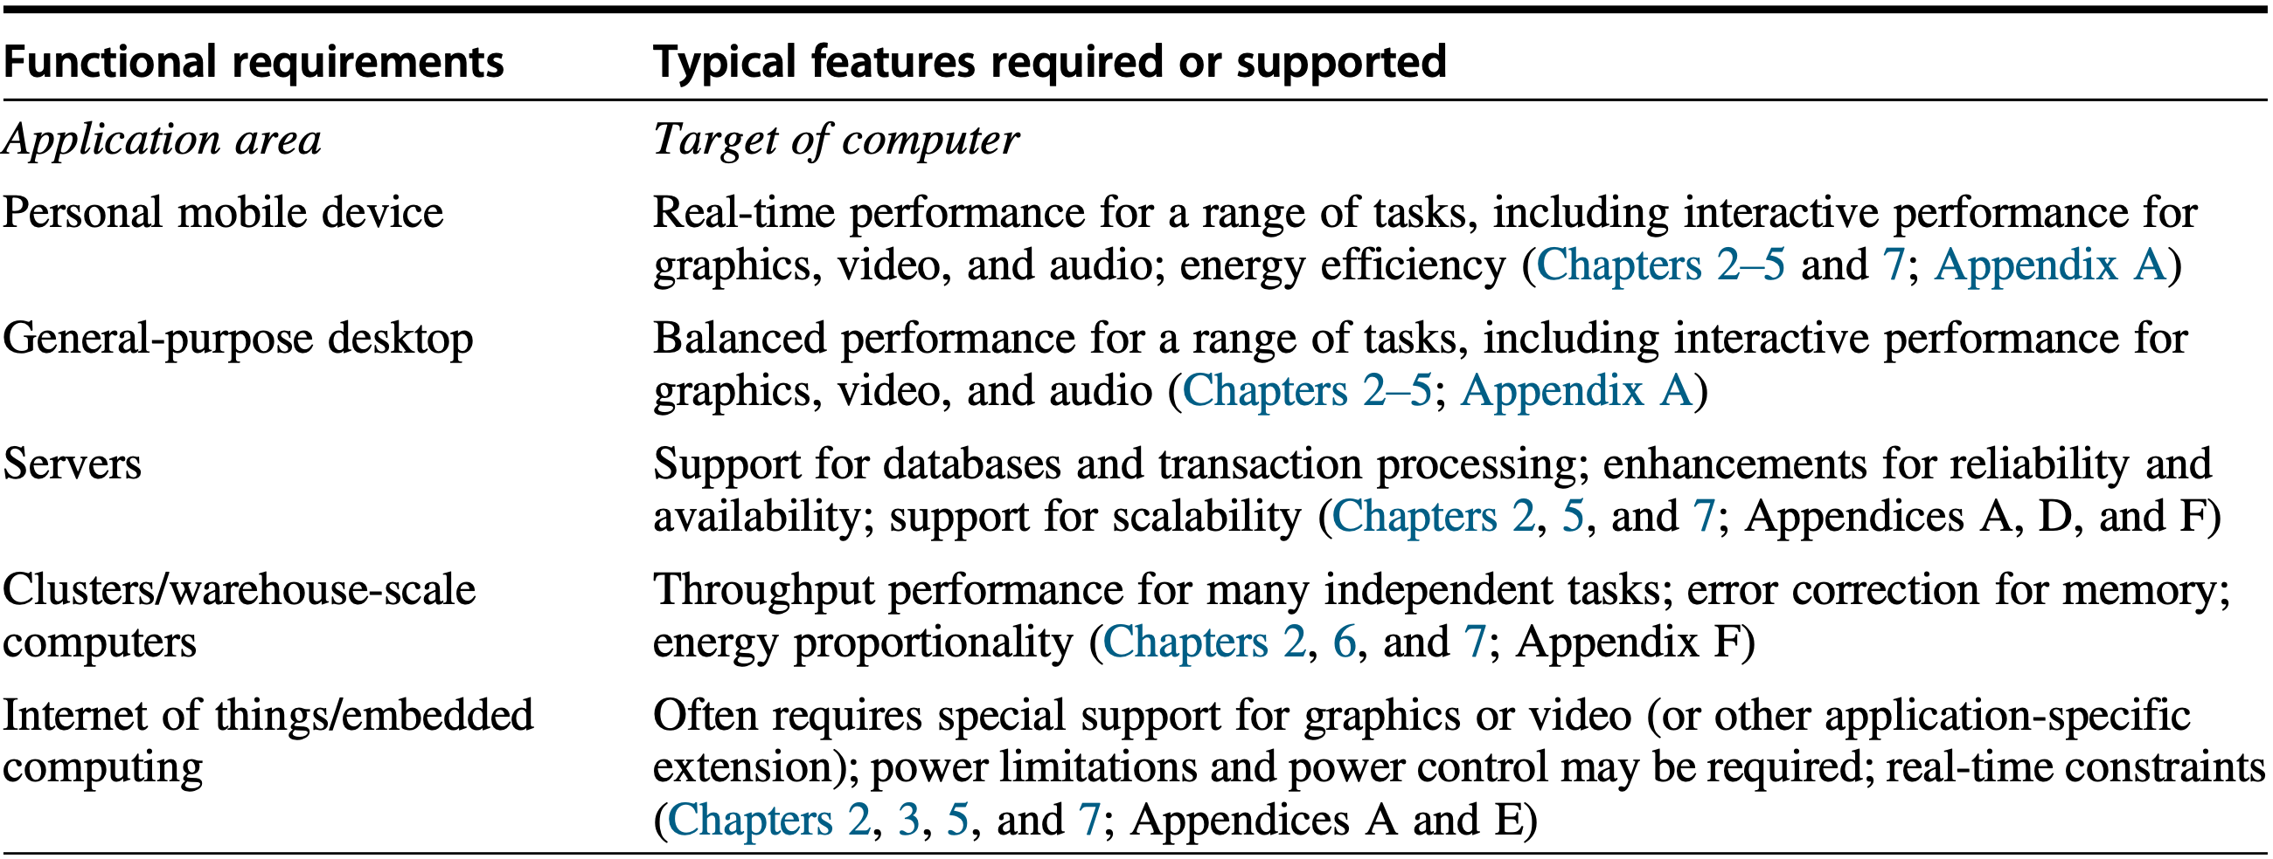
Computer Architecture
ISA
Organization
Hardware
Computer architects must design the organization and hardware
to meet functional requirements
as well as price, power, performance, and availability goals.
Notes:
In summary, computer architects must design the organization and hardware to meet functional requirements as well as price, power, performance, and availability goals.

Slide 138
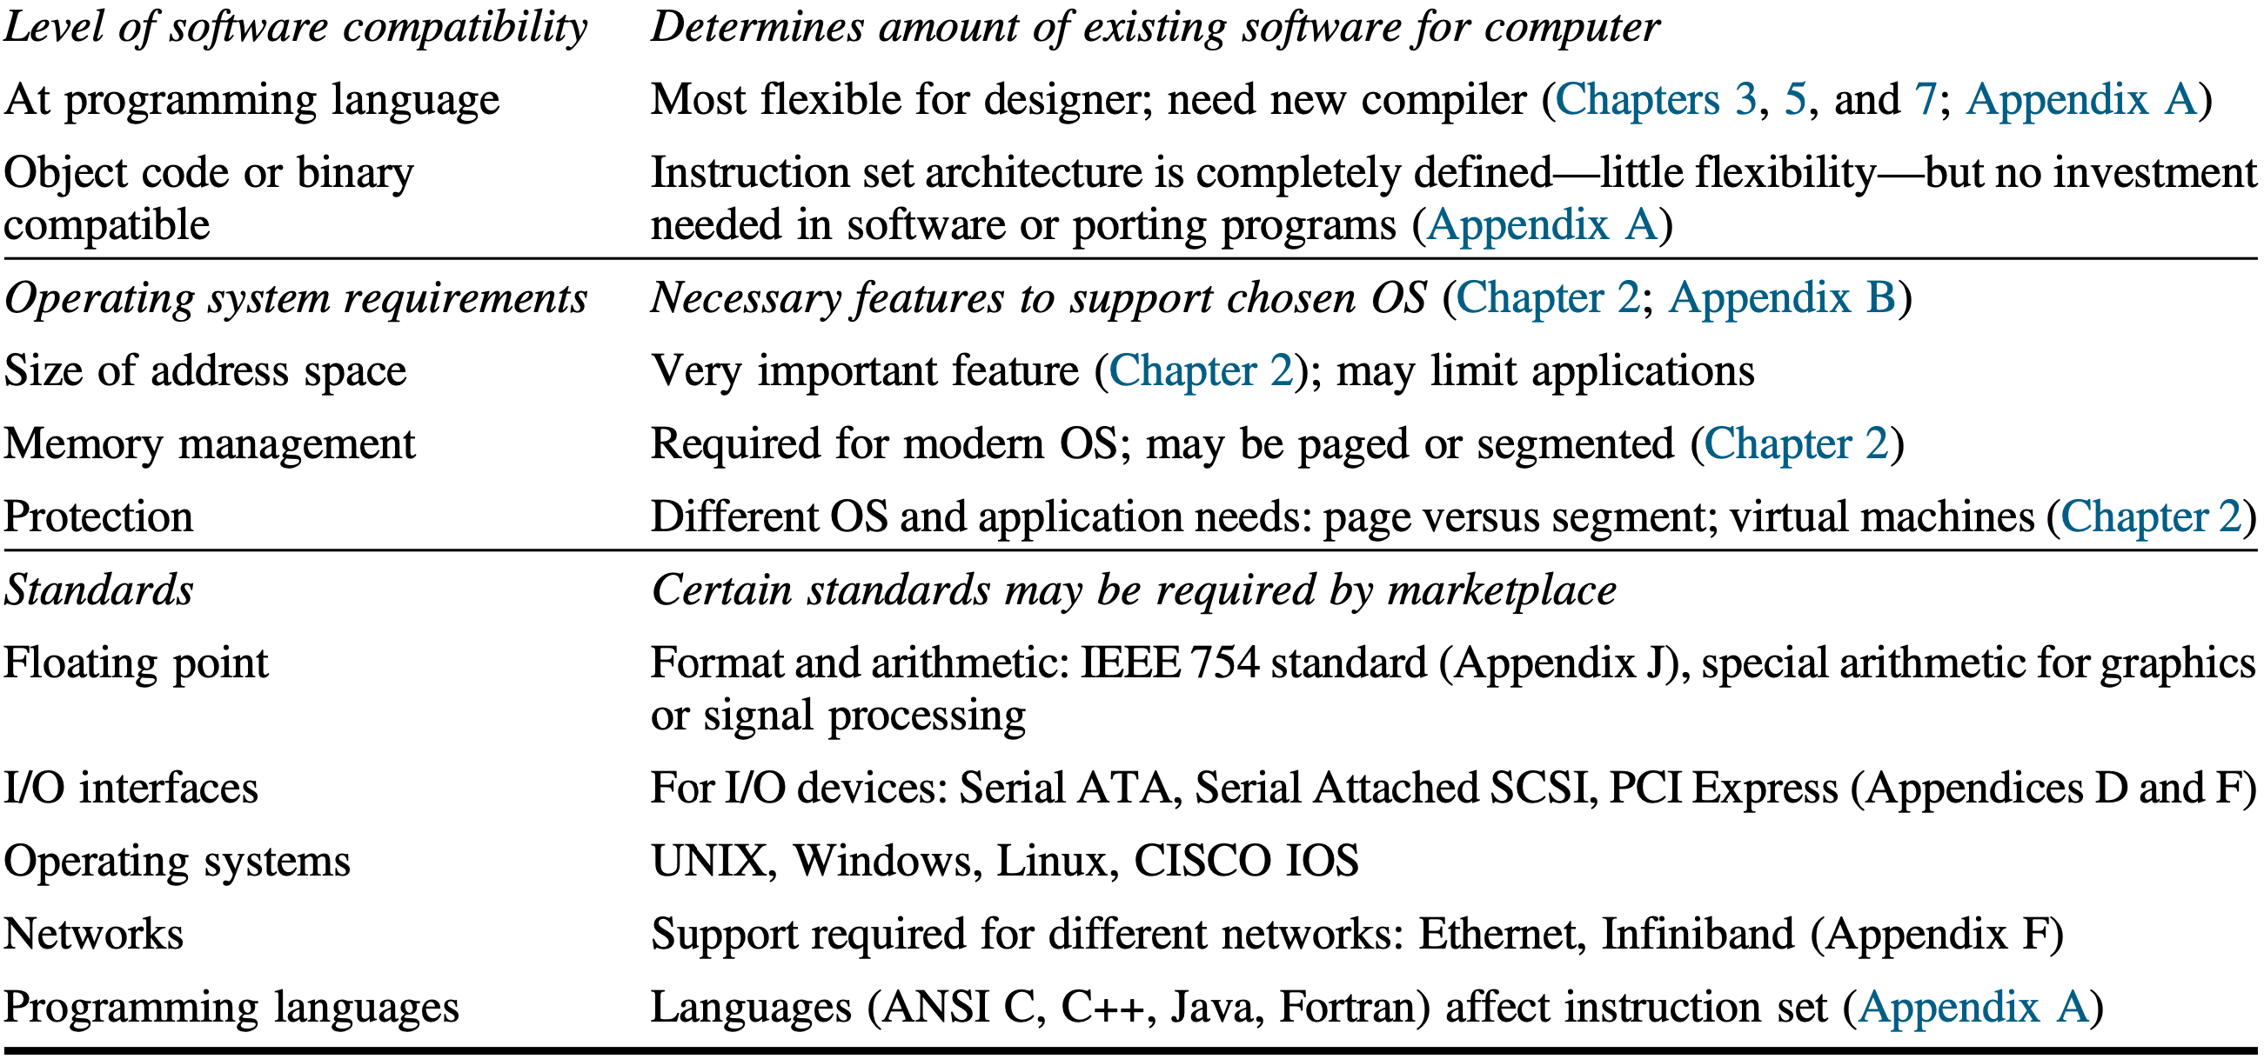
Computer Architecture
ISA
Organization
Hardware
Computer architects must design the organization and hardware
to meet functional requirements
as well as price, power, performance, and availability goals.
Notes:
In summary, computer architects must design the organization and hardware to meet functional requirements as well as price, power, performance, and availability goals.

Slide 139
Review
5 classes of computers
Parallelism
Instruction set architecture
Computer architecture

Slide 140
Classes of Computers
PMD: Personal Mobile Device
Desktop
Server
Cluster/WSC (Warehouse-Scale Computer)
Embedded/IoT computer

Slide 141
Parallelism
Application parallelism:
DLP: Data-Level Parallelism
TLP: Thread-Level Parallelism
Hardware parallelism:
ILP: Instruction-Level Parallelism
Vector Architectures, GPUs, and MM
TLP: Thread-Level Parallelism
RLP: Request-Level Parallelism
Notes:
::
Computer hardware in turn can exploit these two kinds of application parallelism in four major ways:
For hardware parallelism, we have four possible ways.
(Vector Architectures, GPUs - Graphic Process Units, and MM – Multimedia Instruction Sets)
The first one is instruction-level parallelism.

Slide 142
Instruction Set Architecture
Class of ISA
Memory addressing
Addressing modes
Types and sizes of operands
Operations
Control flow instructions
Encoding an ISA

Slide 143
Computer Architecture
Architecture
the parts of a processor that one needs to understand to write assembly code;
directly visible to software;
Microarchitecture
implementation of the architecture
(oops…lack of details)

Slide 144
Computer Architecture
Concentrate more on high-level policy
One policy may associate with multiple enforcement/implementation strategies
Less about why/why-not, as it is just a design choice, does not necessarily regulate all of its kind

Slide 145
Chapter 1.1-1.3
Notes:
The contents discussed can be found in the first part of Chapter 1.

Slide 146
Readings
Appendix A: Instruction Set Principles
Appendix K: Survey of Instruction Set Architectures

Slide 147
Lab 1
Demo Due: October 12, 2022
Report Due: October 19, 2022

Slide 148
Assignment 1
link
25 min presentation per group
October 19, 08:00 – 12:25
Room 502, CGB Building East Wing
Bonus
tbd…for the best presentation group
Suggestions? Make it fun!

Slide 149
?

Slide 150

Thank You
be on the road
Notes:
Run your own race.
Together, hope we’ll enjoy the ride of computer-architecture adventure this semester.

Slide 151
#What’s More
If you can dream it, you can accomplish it.
What's Your Dream by LinkedIn
If not now, when?
The 3 Secrets of Highly Successful Graduates by Reid Hoffman
As I Began to Love Myself
Notes:
With our mutual efforts, let’s engage more in this class so that we can really ENJOY the teaching and learning process.

